Slide 1
GURU TEGH BAHADUR INSTITUTE OF TECHNOLOGY
DEPARTMENT OF COMPUTER SCIENCE AND ENGINEERING
Event Details from January 2025 to December 2025

Slide 2
“Java Full Stack Development”- Workshop
📅 Recent Event: Workshop on "Java Full Stack Development" 📅 Date: 22nd January, 2025 📍 Venue: BVS Auditorium, GTBIT 🎤 Speaker: Mr. Rishabh Sinha 📚 Faculty Coordinator: Dr. Poonam Narang
🔹 Key Highlights: ✔️ Hands-on sessions on full stack development ✔️ Best practices for modern web applications ✔️ Interactive Q&A session with the speaker

Slide 3
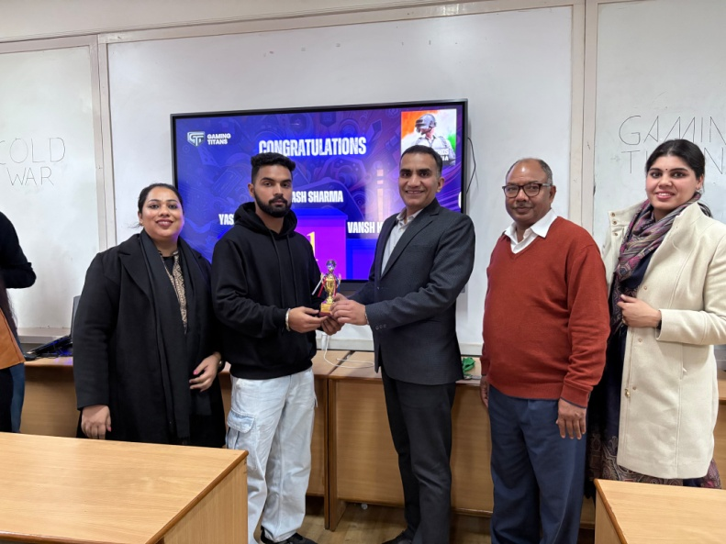
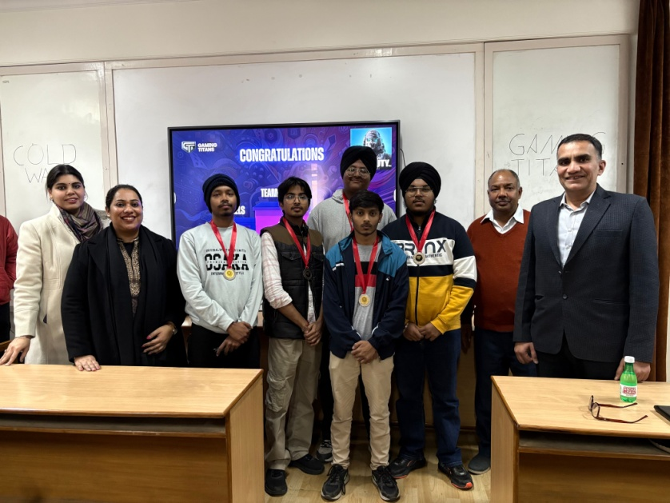
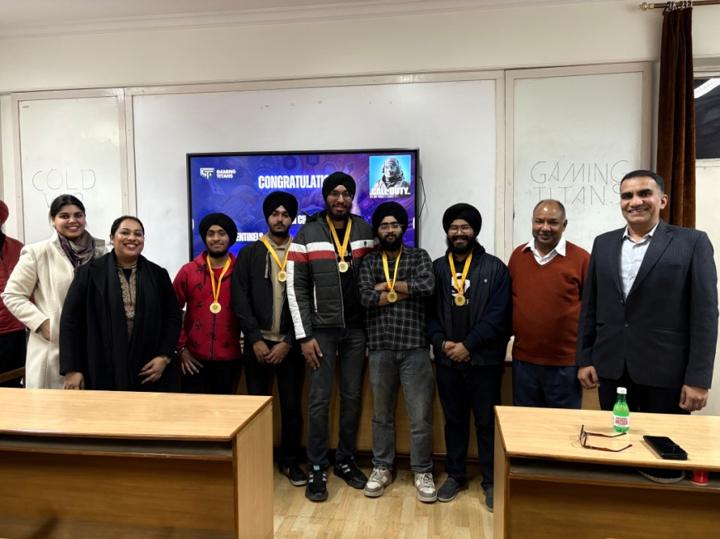
"COLDWAR" on 4th February 2025 The Gaming Society of GTBIT, GAMING TITANS

Slide 4
Webinar on Cyber Security
📅 Event: Webinar on "Cyber Security" 📅 Date: 15th February, 2025 📍 Organized By: CSI India for CSE, GTBIT 🎤 Speaker: Mr. Abhijit C. 📚 Faculty Coordinator: Ms. Basanti Pal Nandi
🔹 Key Highlights: ✔️ Discussion on emerging cybersecurity threats ✔️ Hands-on demonstrations of security measures ✔️ Interactive Q&A session with the speaker

Slide 5
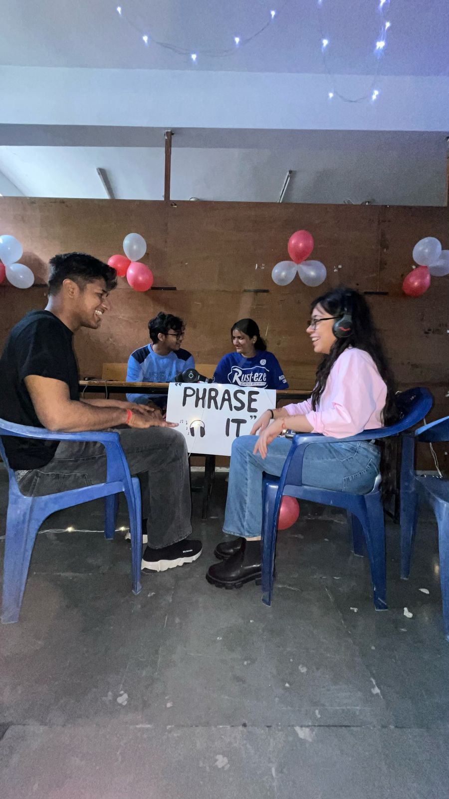
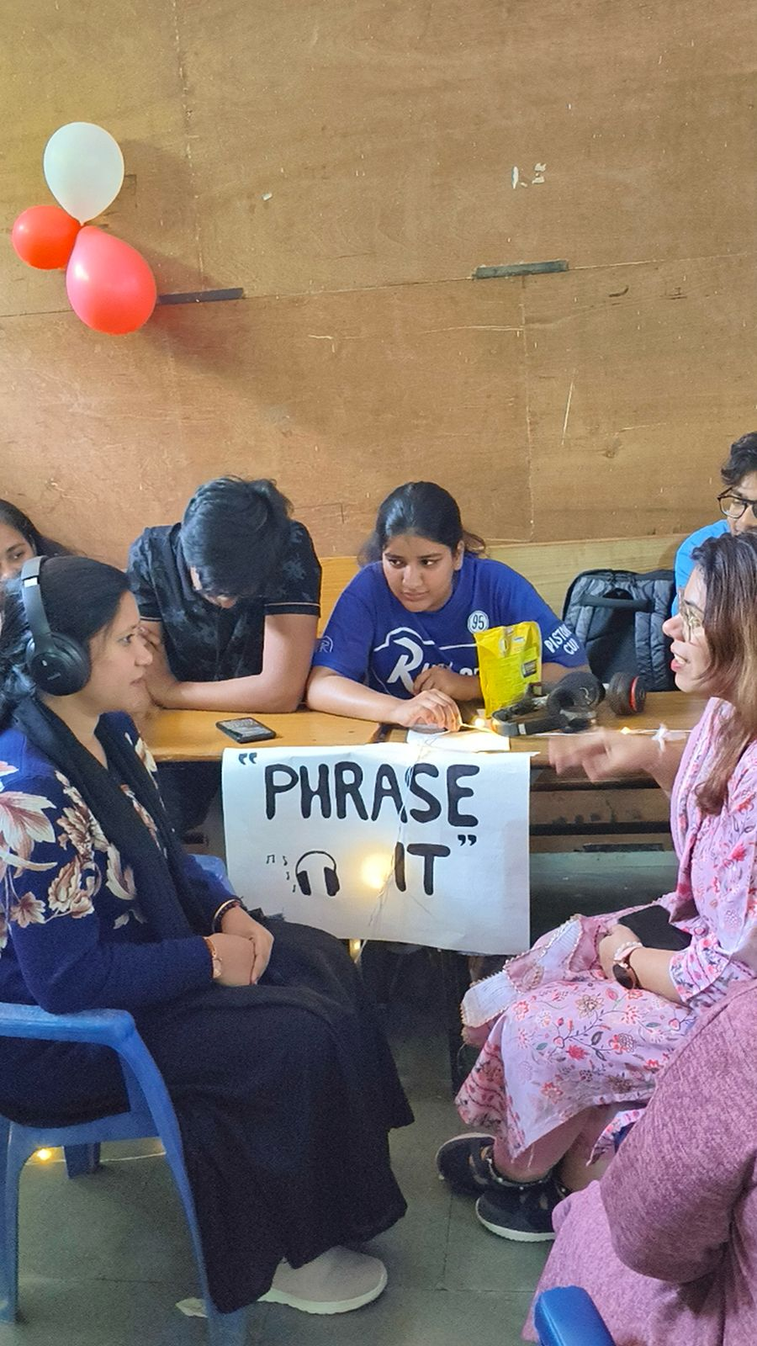
EVENT NAME: CODE QUEST 🕹 HOSTED BY: 15FORTEEN On 18th February,2025

Slide 6
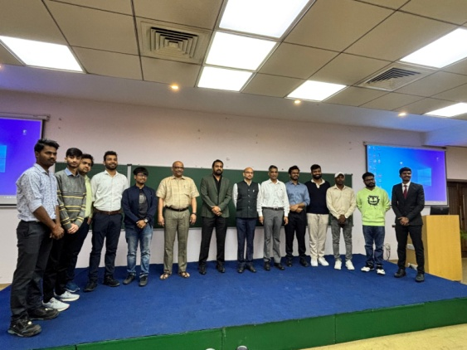
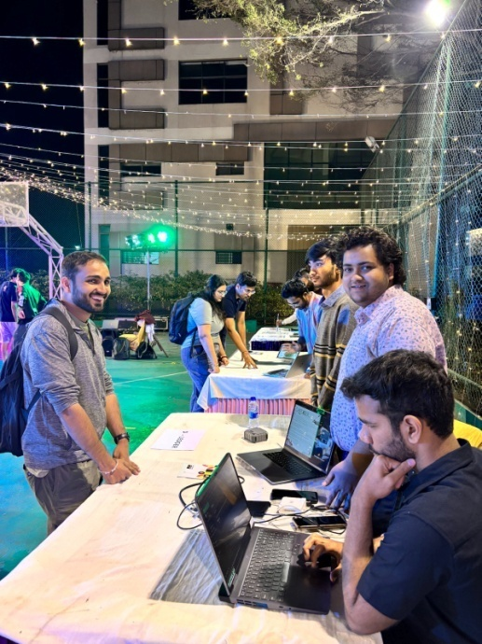
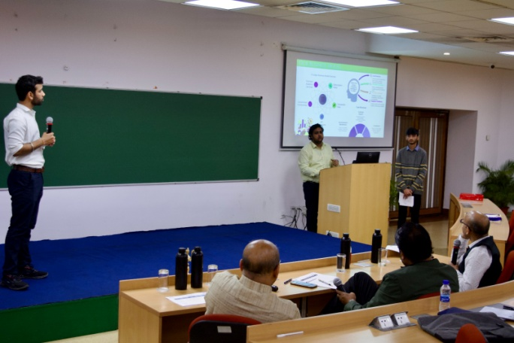
XLRI Entrepreneurship Summit (XES) 2025
XLRI Entrepreneurship Summit (XES) 2025 📅 Date: 4th February 2025 📍 Event: XLRI Entrepreneurship Summit (XES)
Participants: Nishant Garg & Abbas Ali (CSE Dept., GTBIT)
Highlights: ✅ Represented GTBIT at a prestigious national-level summit ✅ Showcased innovation & entrepreneurial spirit fostered by E-Cell XLRI ✅ Strengthened our institute’s reputation on a national platform

Slide 7
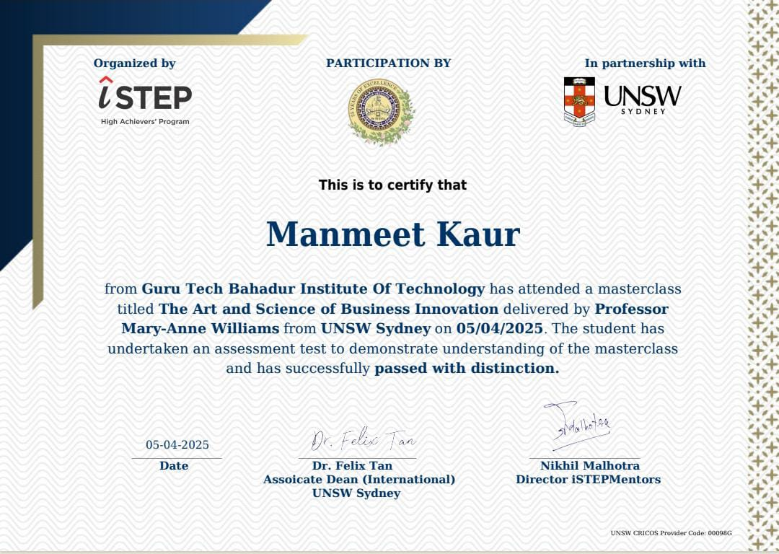
Webinar on The Art and Science of Business Innovation
Organized by:
CSE Department, GTBIT In Association with ISTEP
Date: 5th April 2025 (Saturday) Time: 11:00 AM Mode: Online Total Participants: 109
Objectives:
Understand fundamentals of business innovation
Explore creativity + structured problem-solving
Study real-world innovation case studies
Prepare for innovation-driven industry demands
Highlights:
Engaged students and faculty in innovation thinking
Delivered by expert speakers from academia & industry
Post-webinar assessment conducted

Slide 8
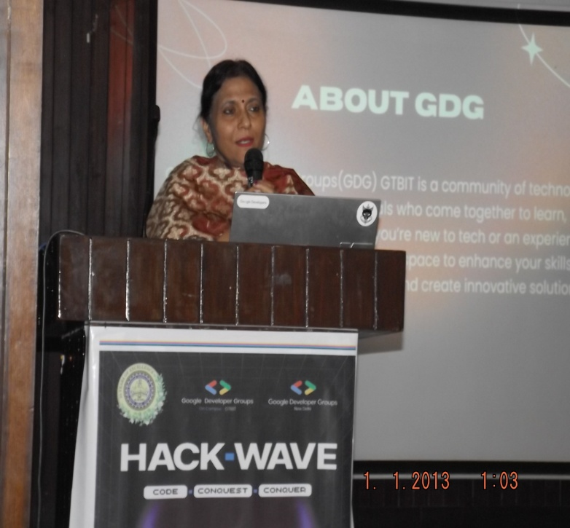
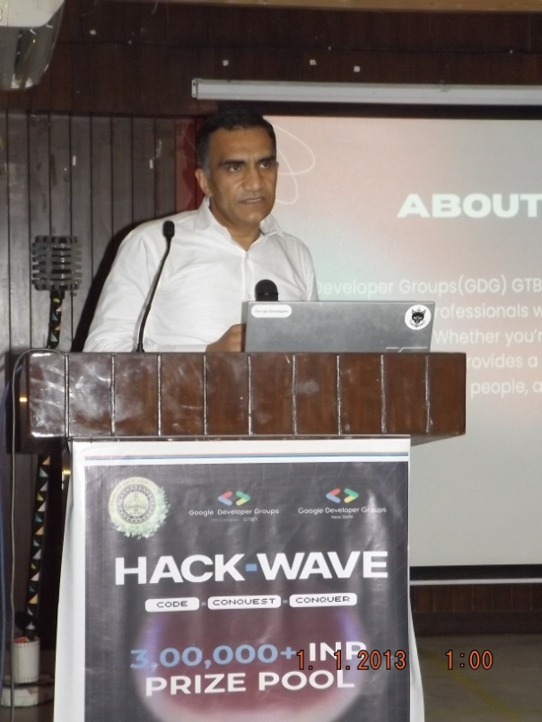
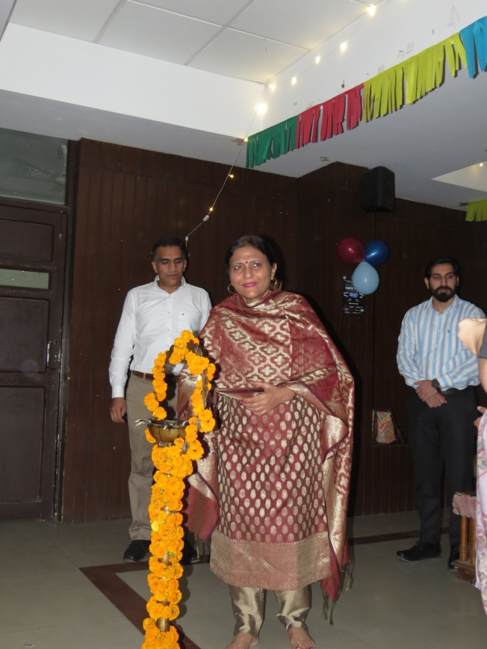
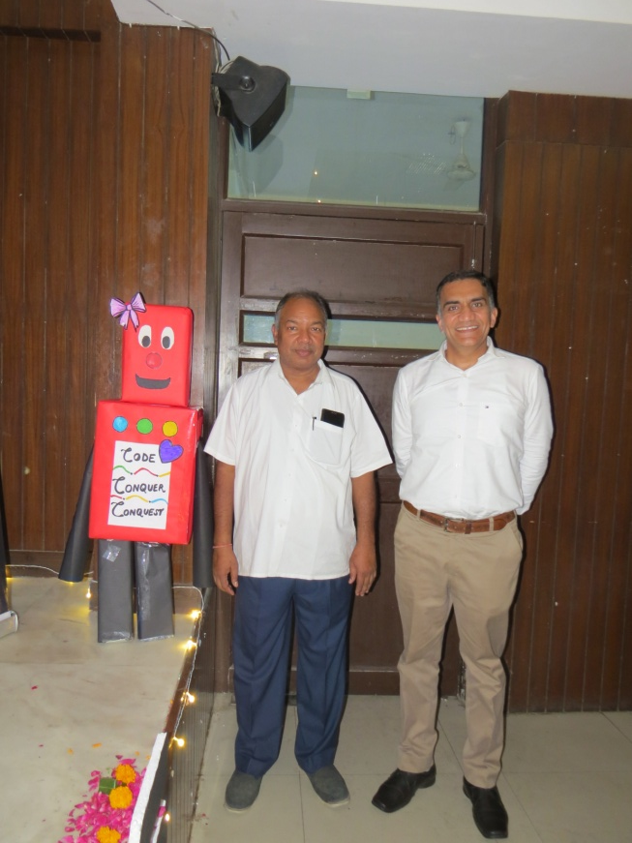
HACKWAVE’25 6th May, 2025-7th May, 2025 ORGANIZED BY Google Developer Groups On-Campus, GTBIT IN ASSOCIATION WITH CSE Department, GTBIT

Slide 9
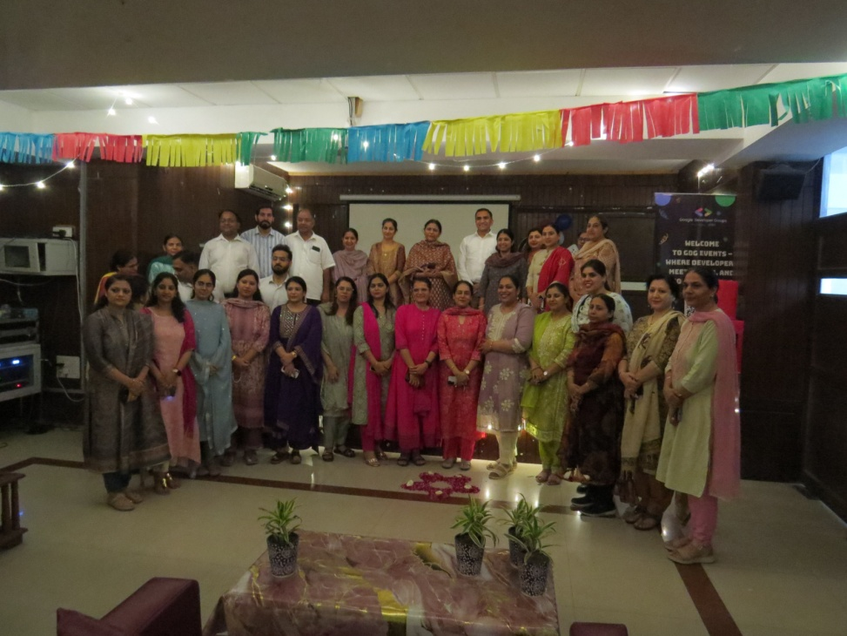
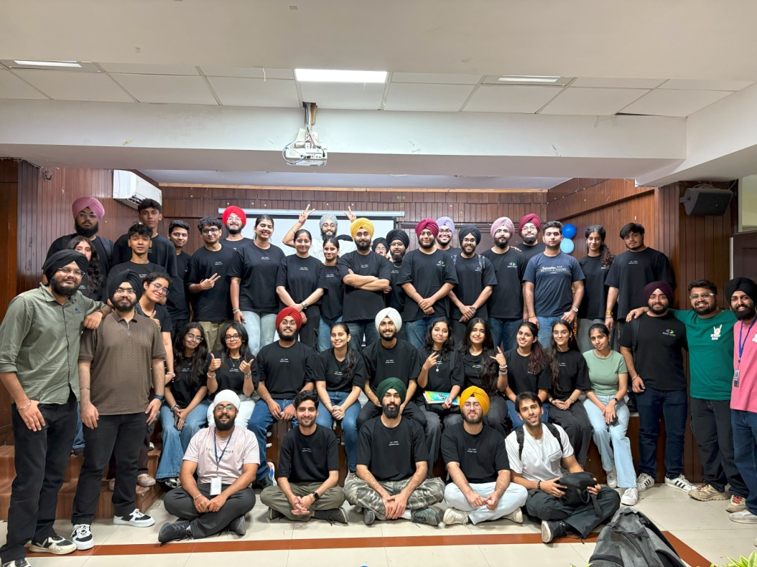
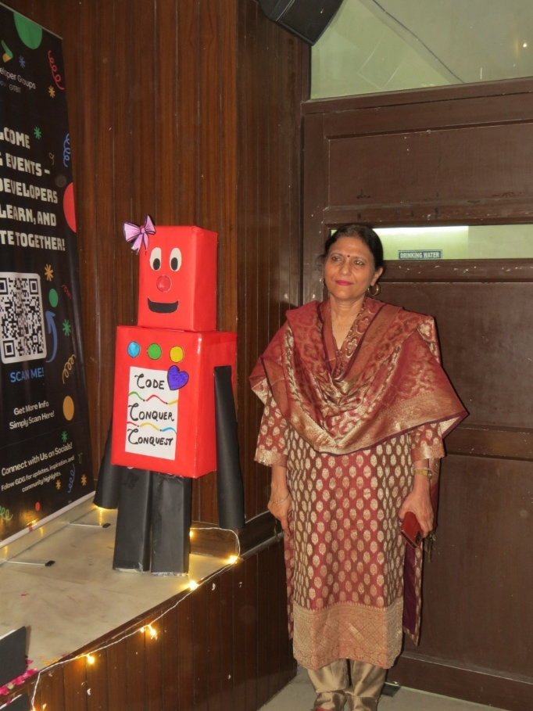
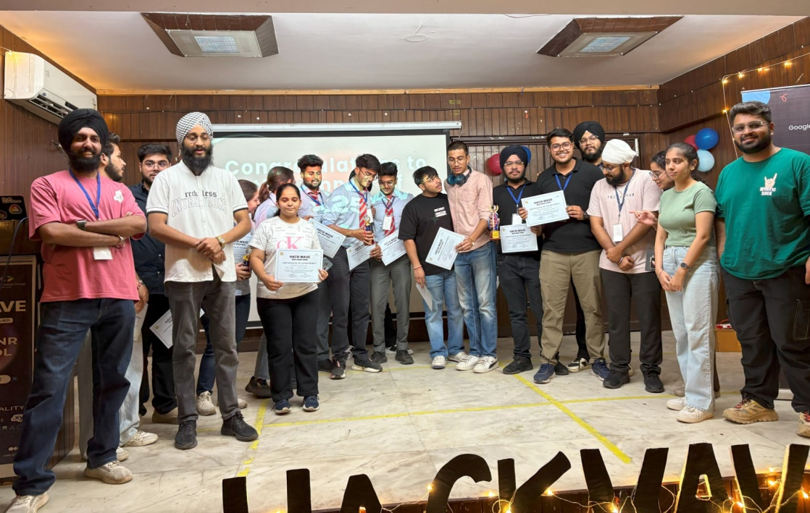
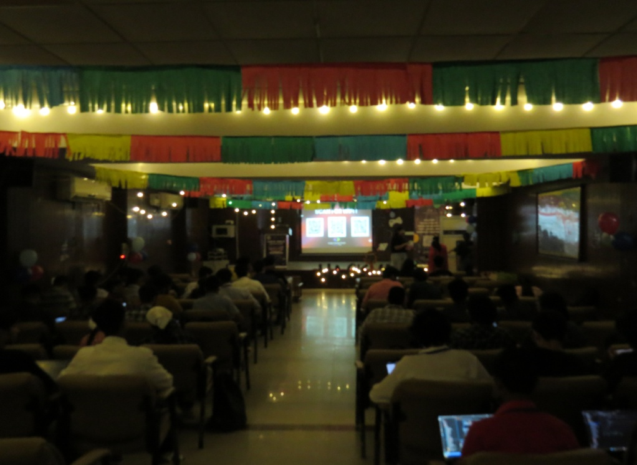

Slide 10
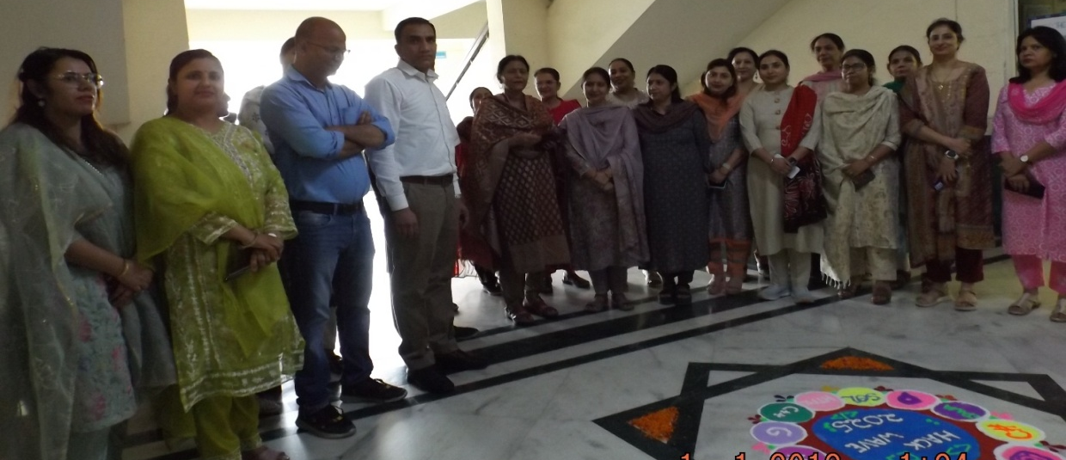
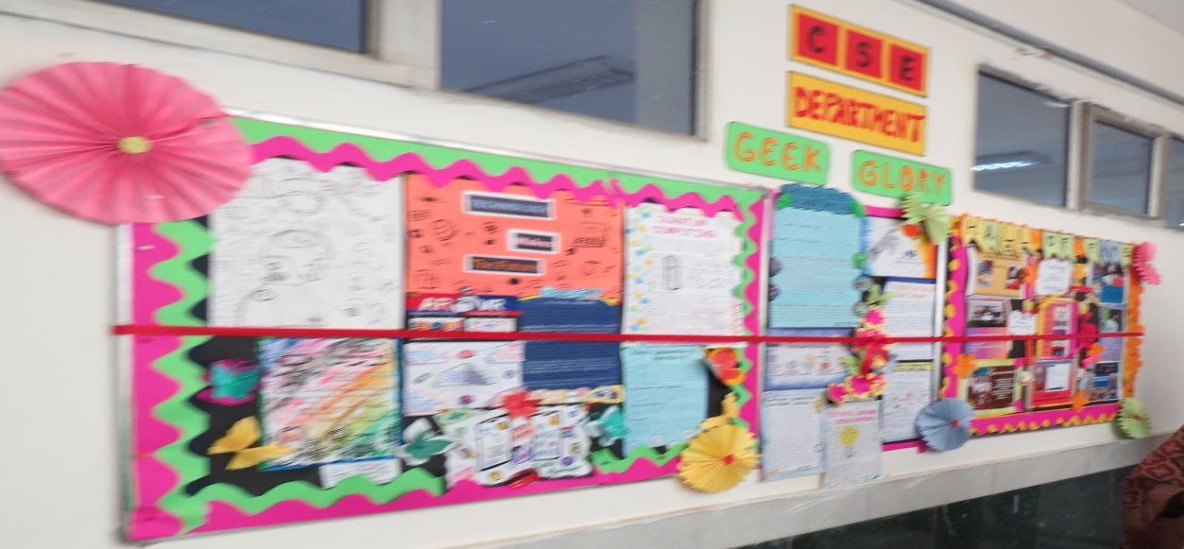
Inauguration of the Wall Magazine Department of Computer Science & Engineering, GTBIT Date: 6th May 2025 Venue: Lab Block, 2nd Floor, GTBIT
About the Initiative:
Launch of a Wall Magazine to celebrate and showcase:
🏆 Achievements: Academic excellence, projects, research, and competitions
🎨 Creative Corner: Poems, articles, artwork, and posters by students
Inaugurated by: Director, GTBIT In the presence of senior dignitaries, faculty members, and the entire CSE Department
Highlights: Colorful Rangoli by students Director’s praise for encouraging student achievements

Slide 11
