Slide 1
EVENT REPORT SANSAD 2025
COMMUNIQUÉ GTBIT Presents

Slide 2
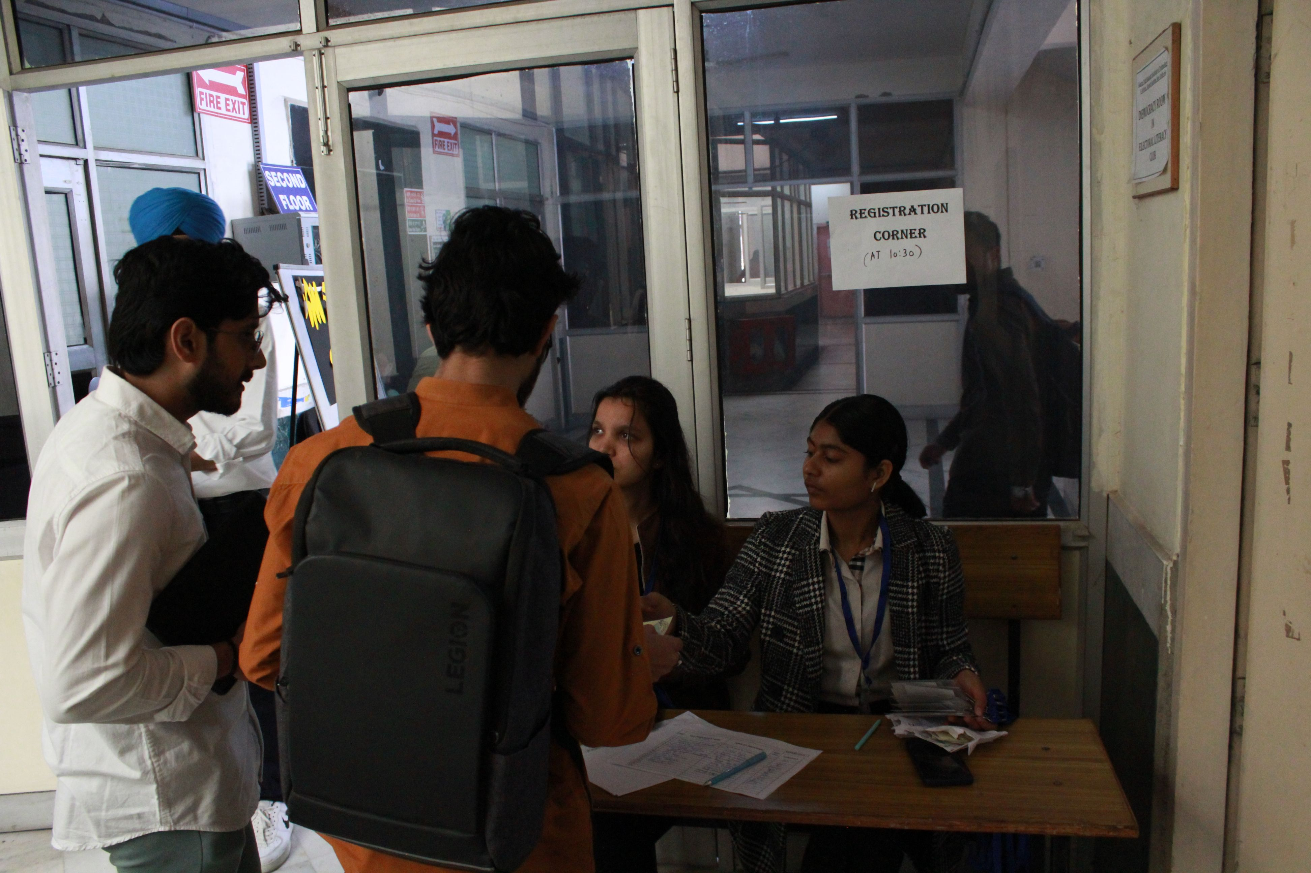
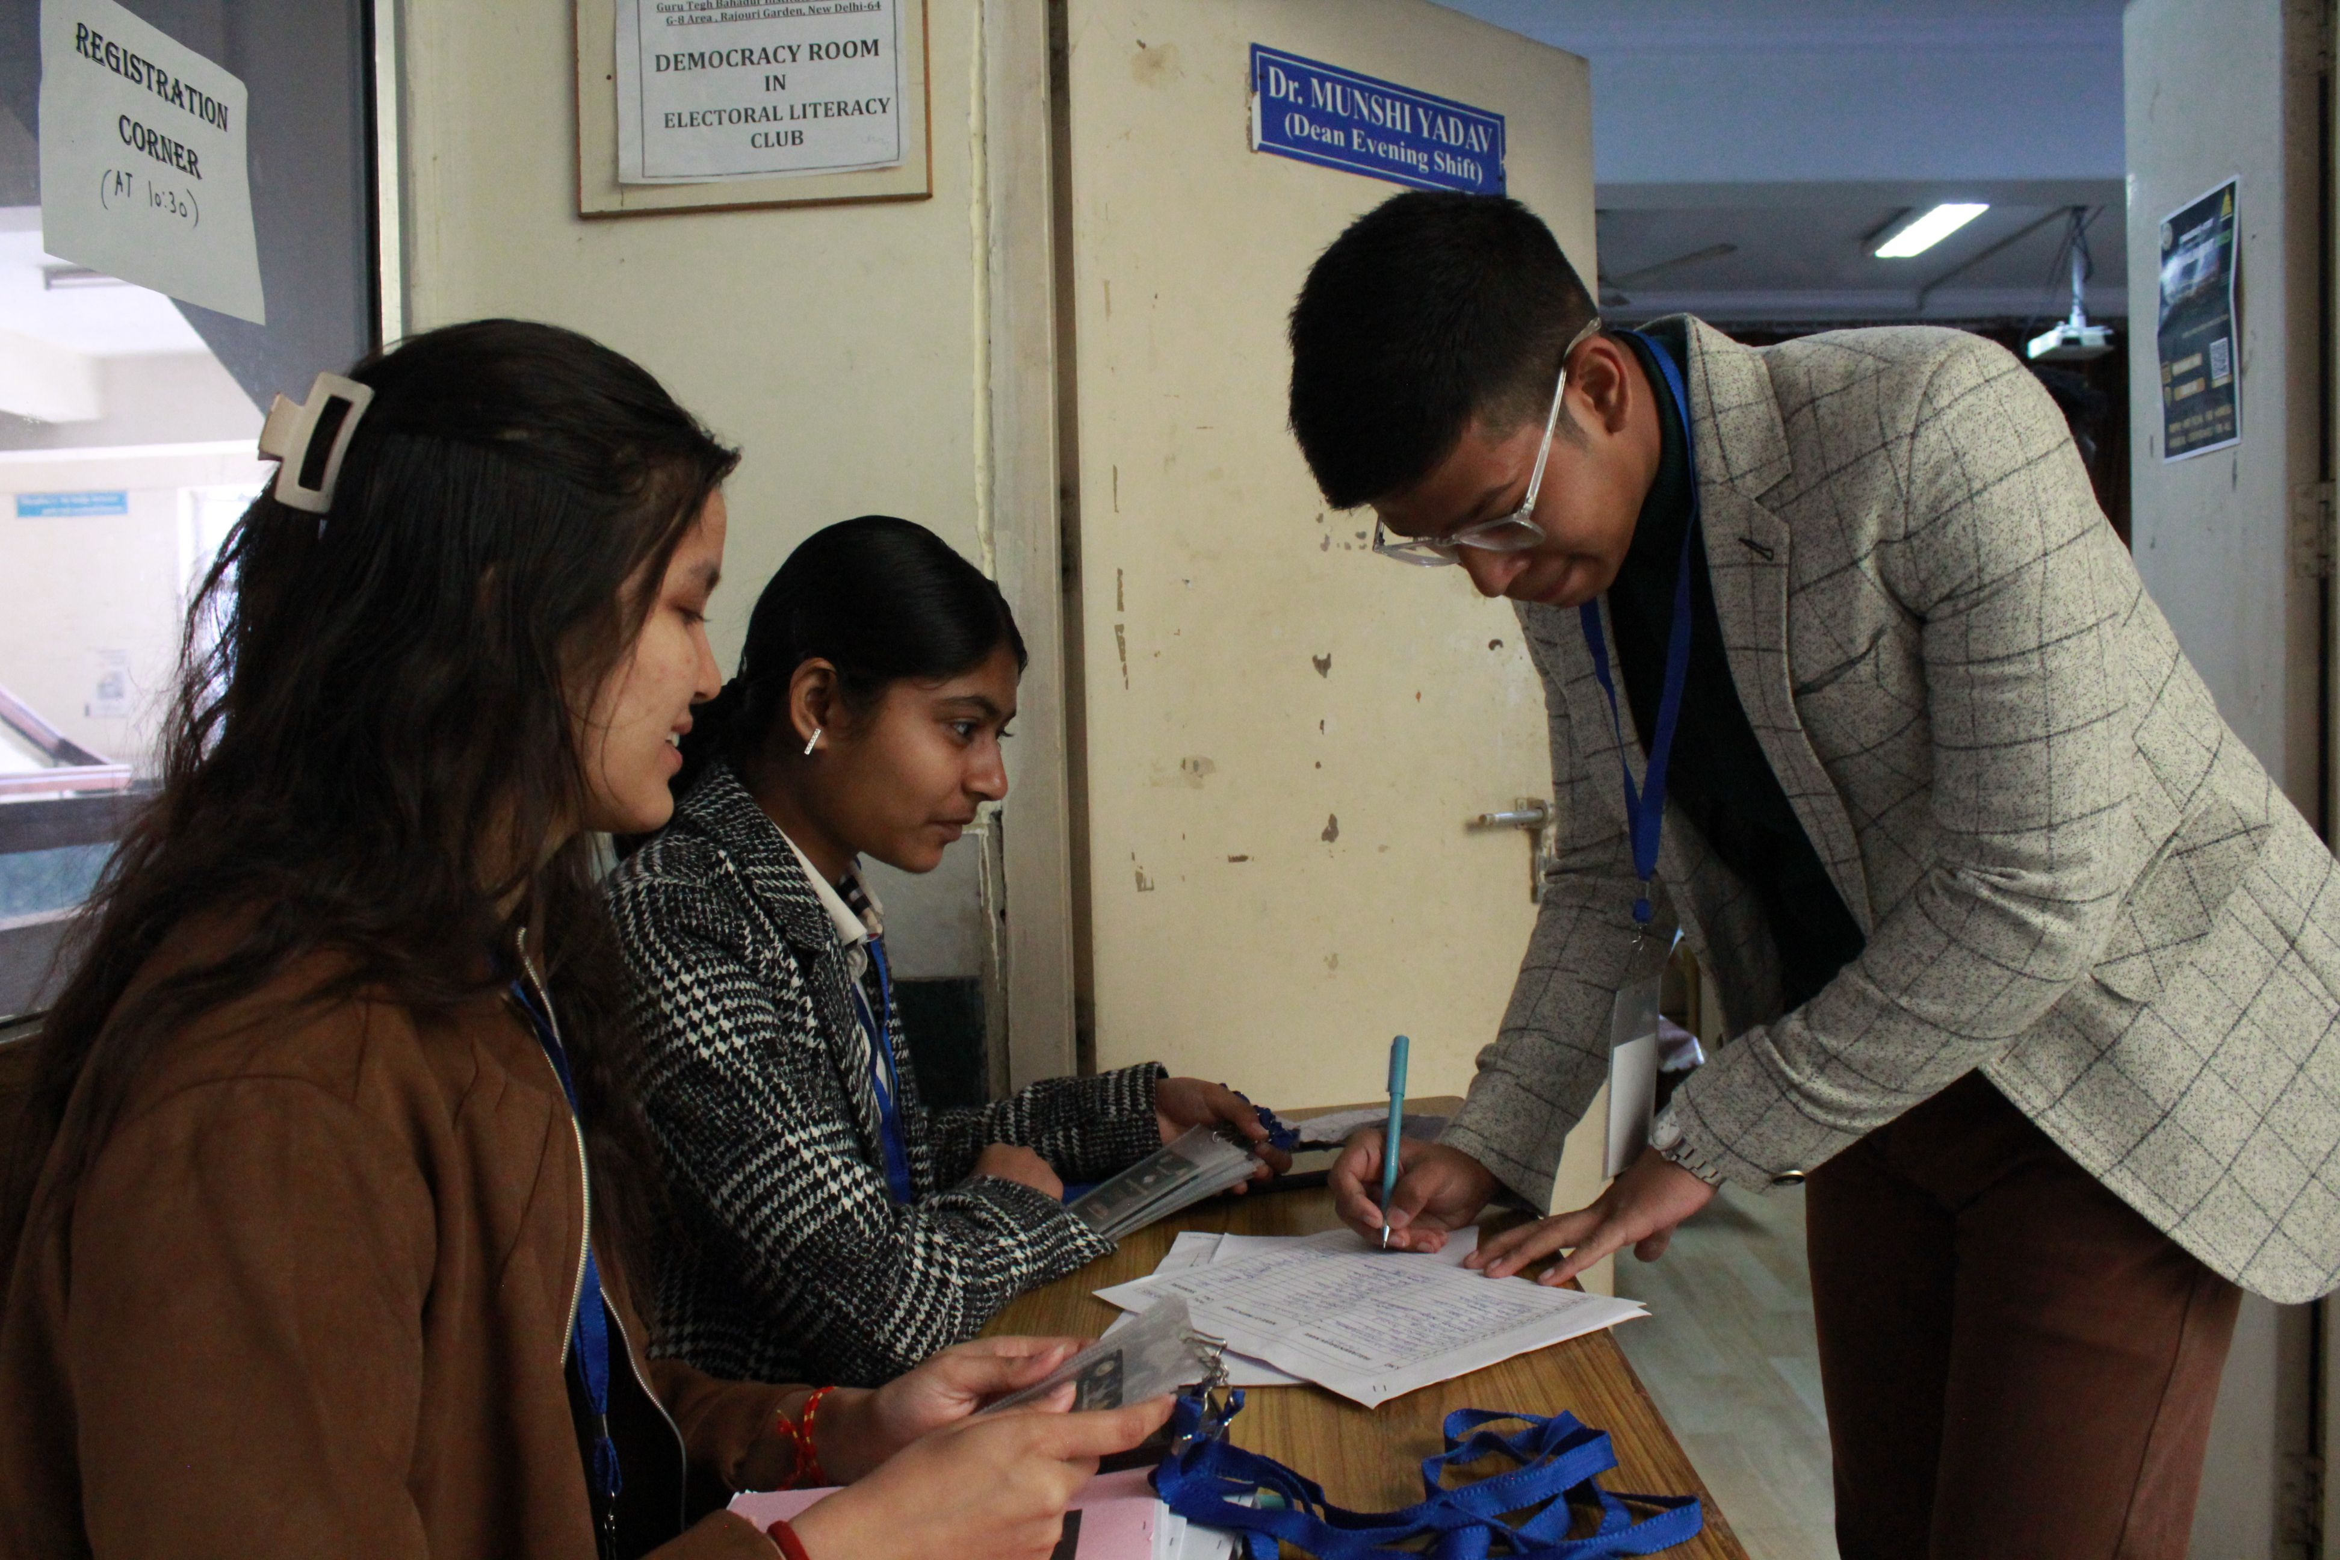
.

Slide 3
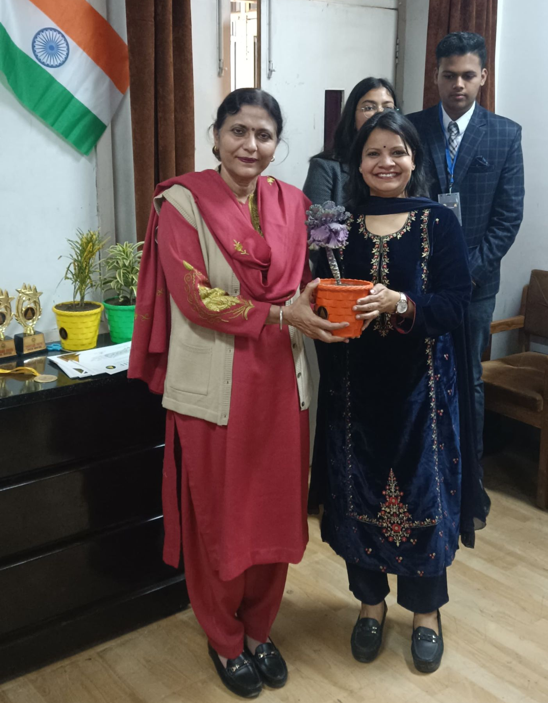
.
As the debate unfolded, the atmosphere became charged with dynamic exchanges and well-reasoned arguments. During this time, the Director Ma'am arrived and was warmly welcomed. She was felicitated and presented with a short video showcasing Communiqué’s remarkable one-year journey, highlighting the society’s growth and achievements. Her presence added a significant moment to the event, reinforcing the importance of structured debate and leadership in academic spaces.

Slide 4
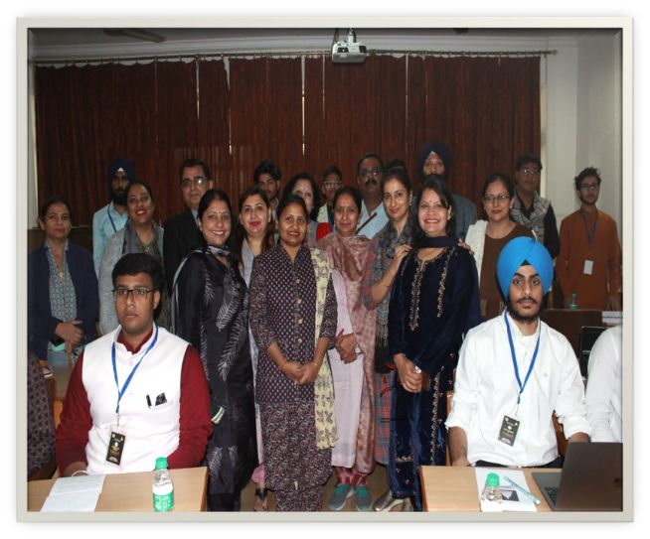

Slide 6
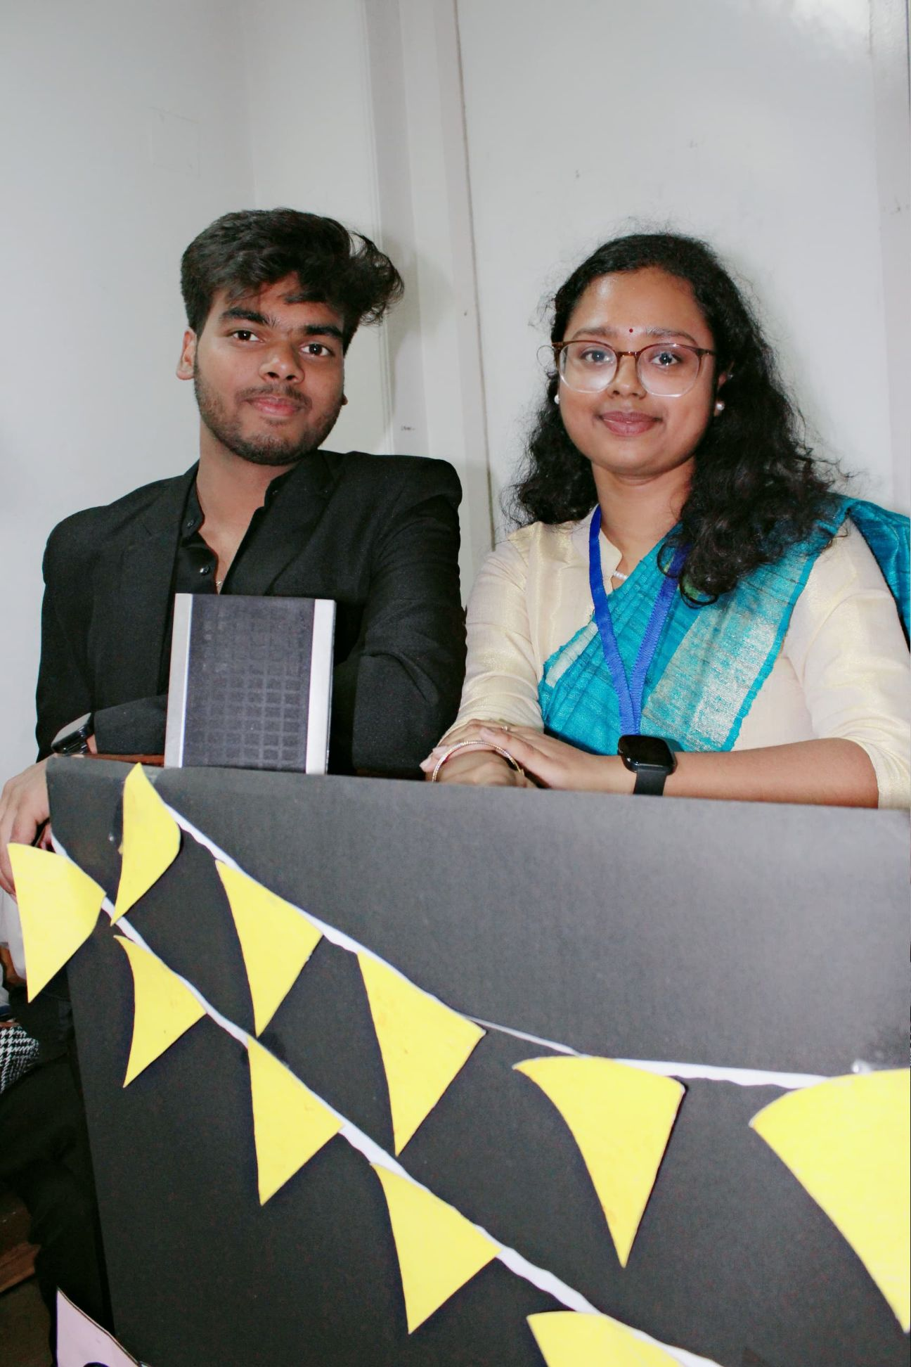
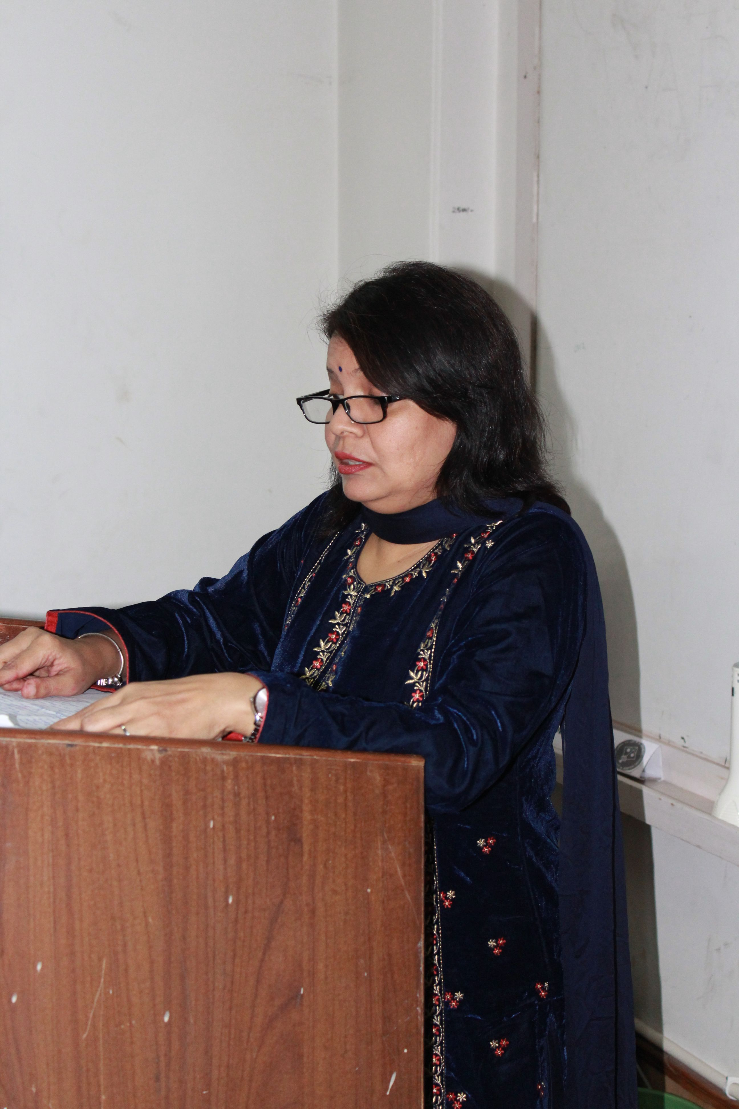
The event began with a formal introduction to Sansad and Communiqué, followed by a warm welcome extended to all the esteemed faculty members and Heads of Departments present. The agenda was then introduced, setting the stage for a structured and unbiased debate. Dr. Himani, the Convener, addressed the assembly, emphasizing the importance of fairness and impartiality in the discussions. Her words reinforced the need for a discourse free from personal bias, laying the foundation for a disciplined and productive session.
.

Slide 7
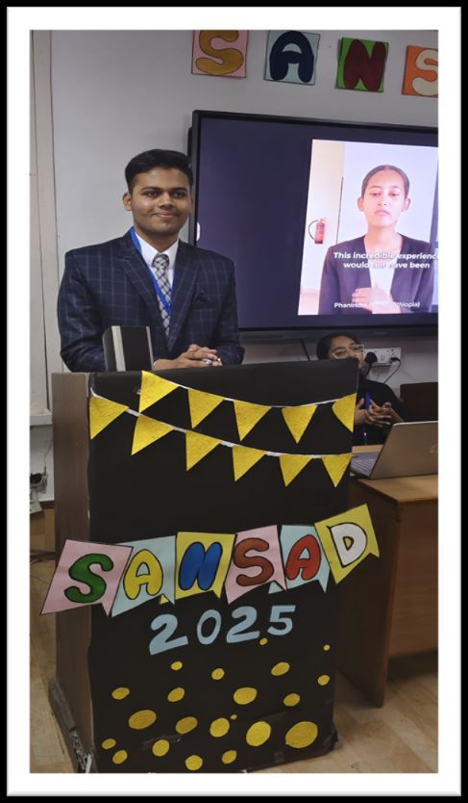
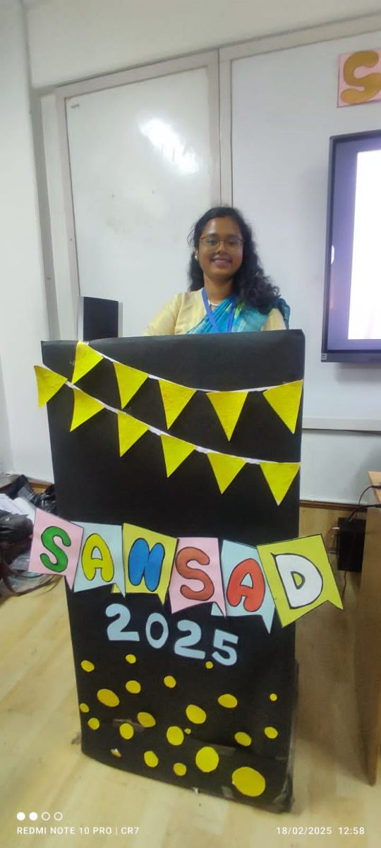
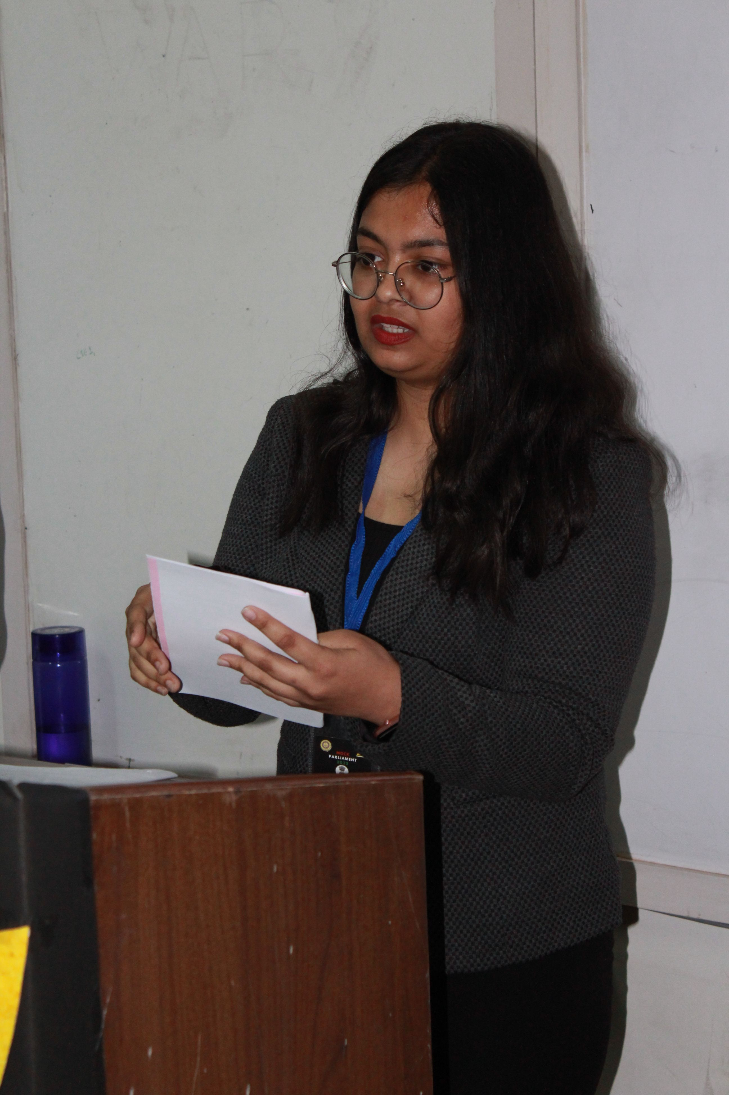

Slide 8
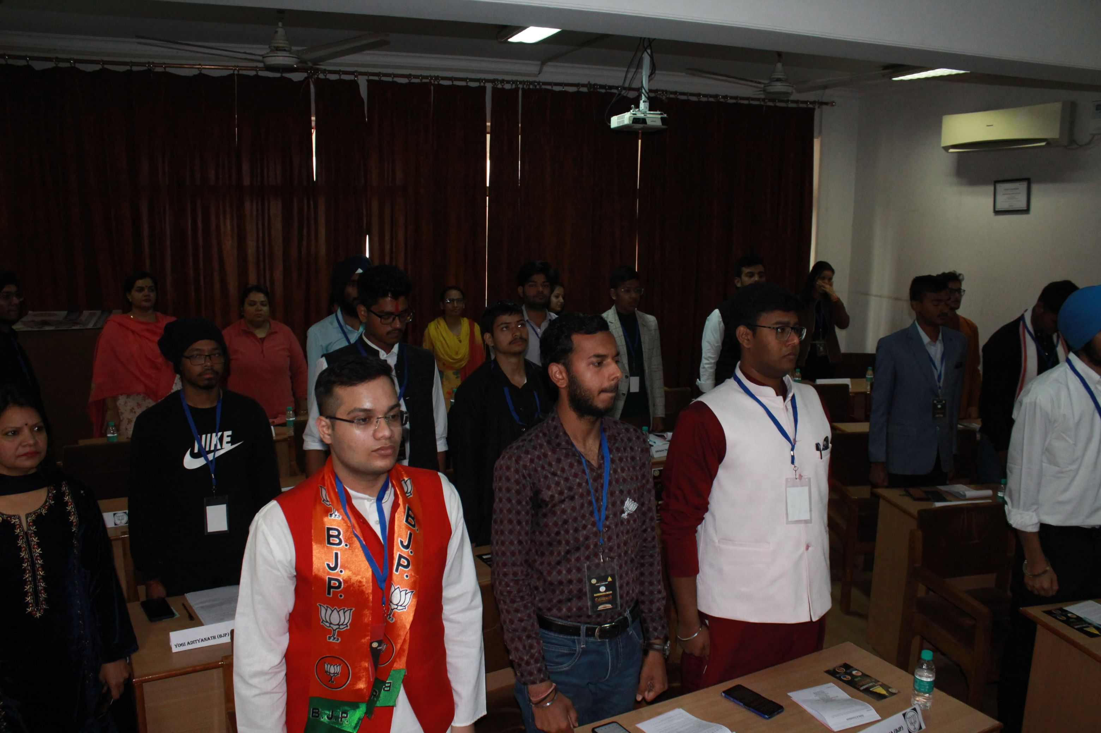

Slide 10
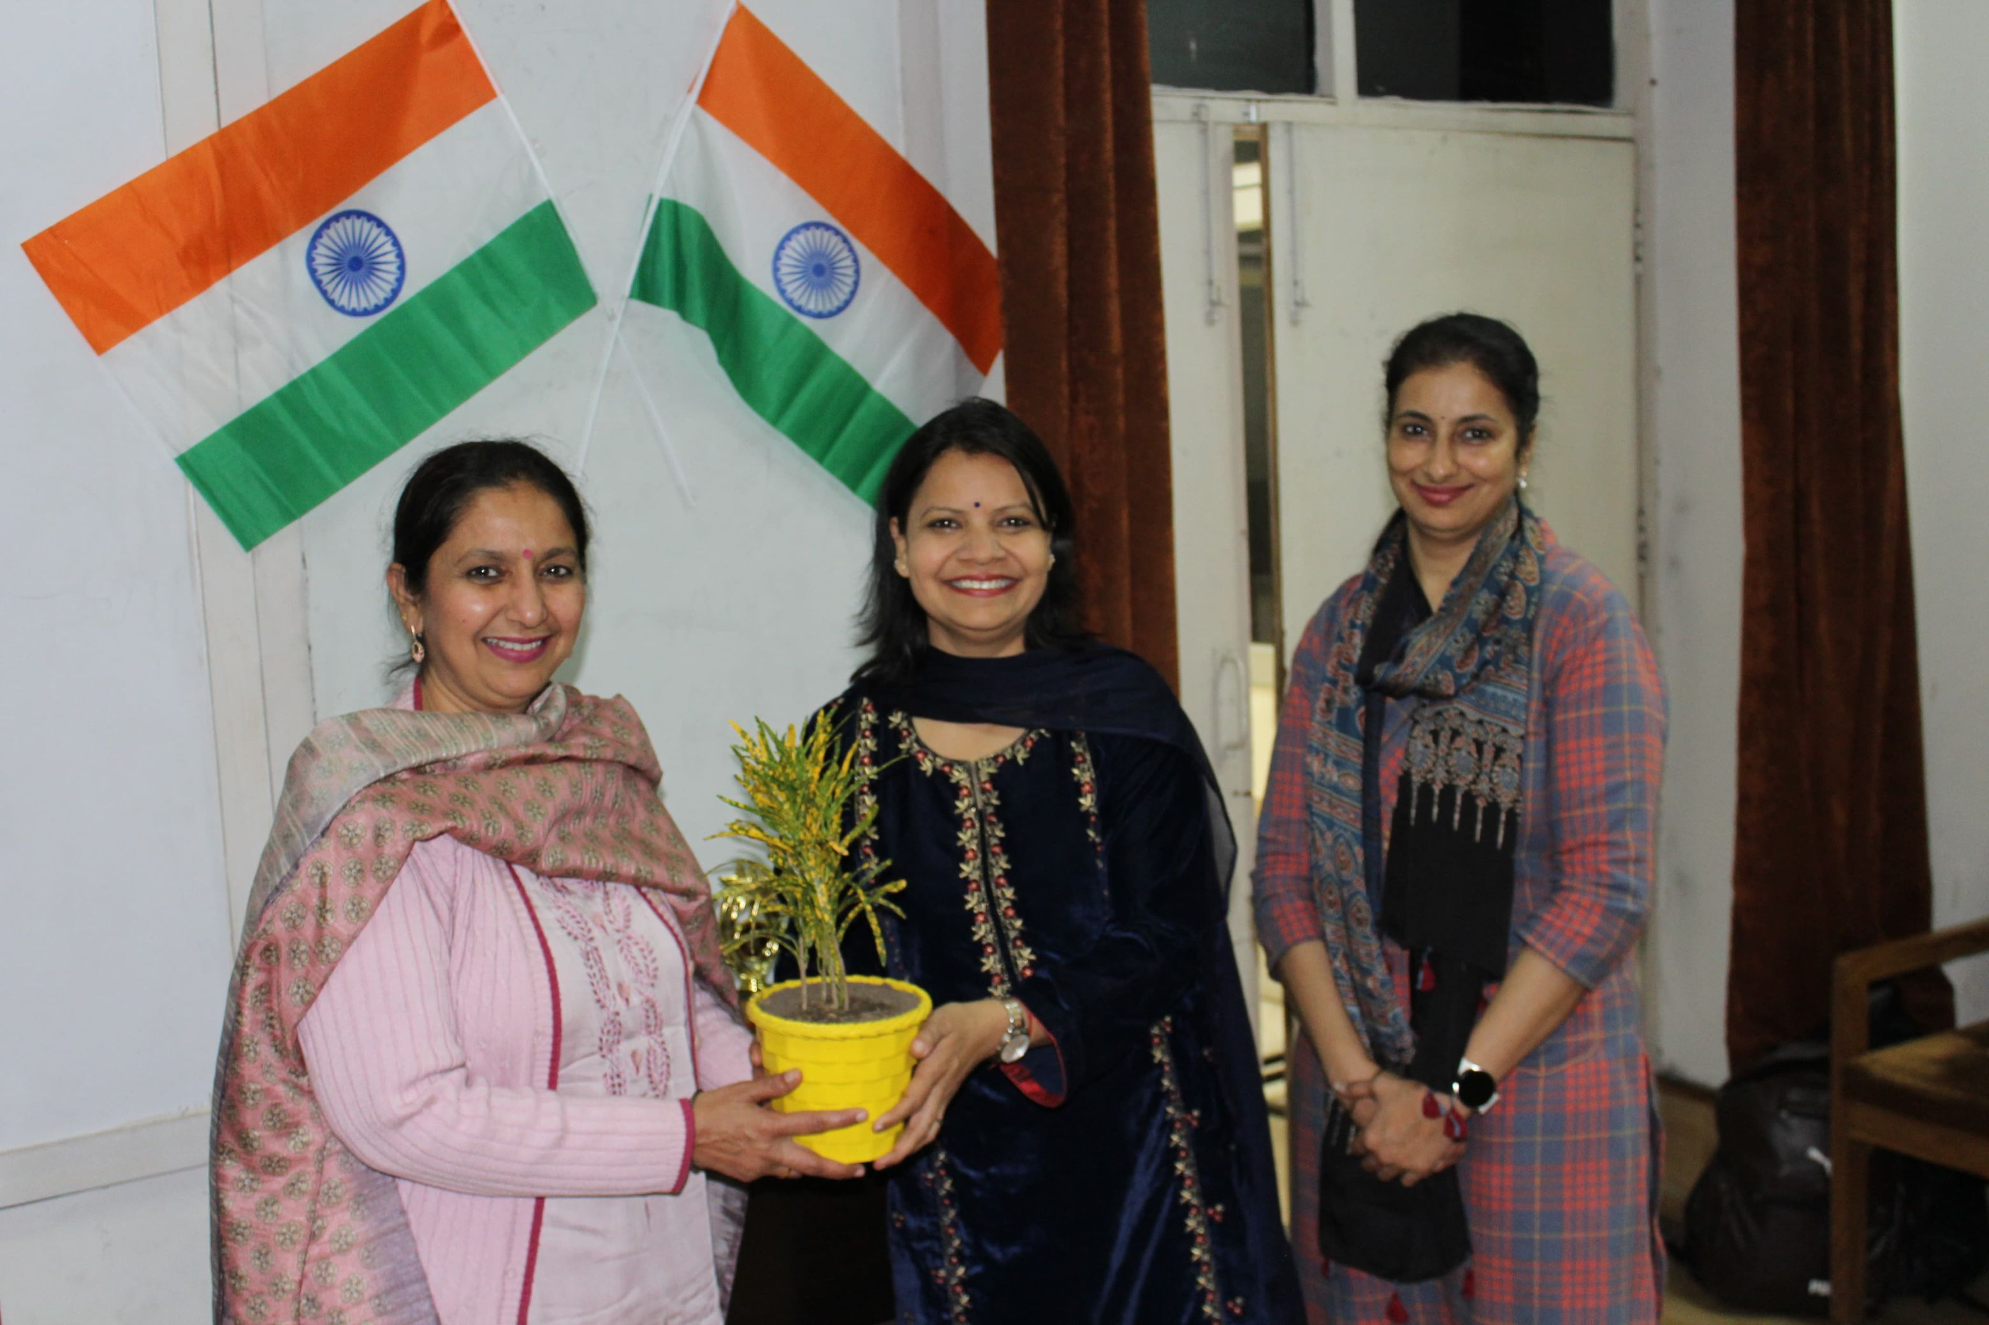
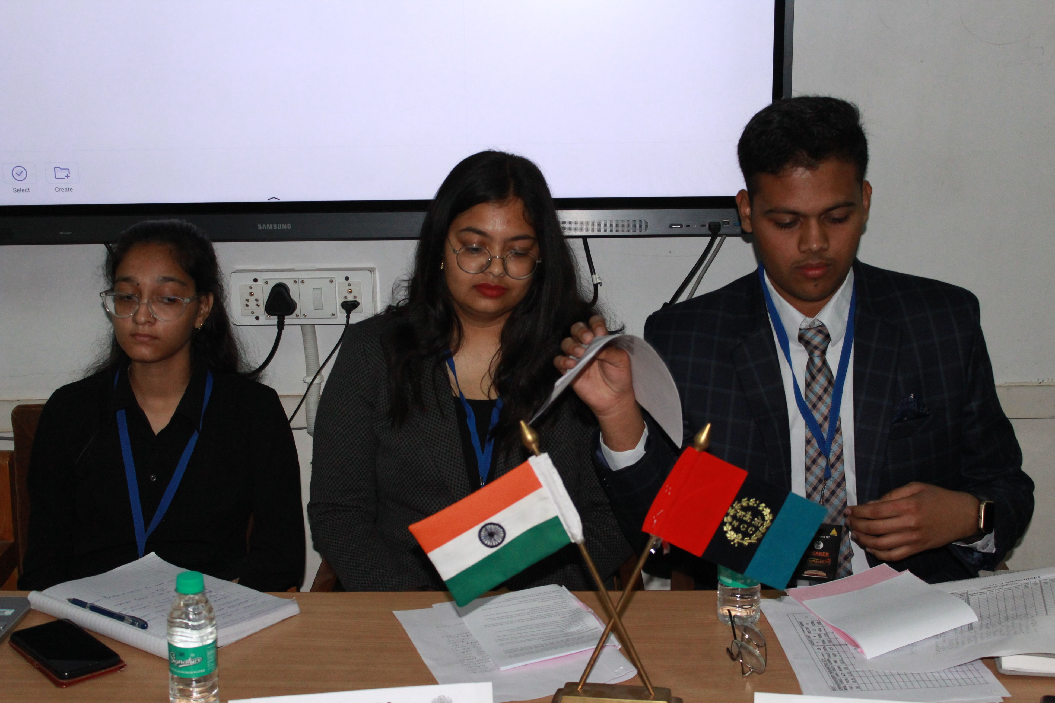
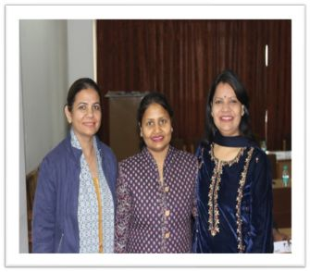
.

Slide 11
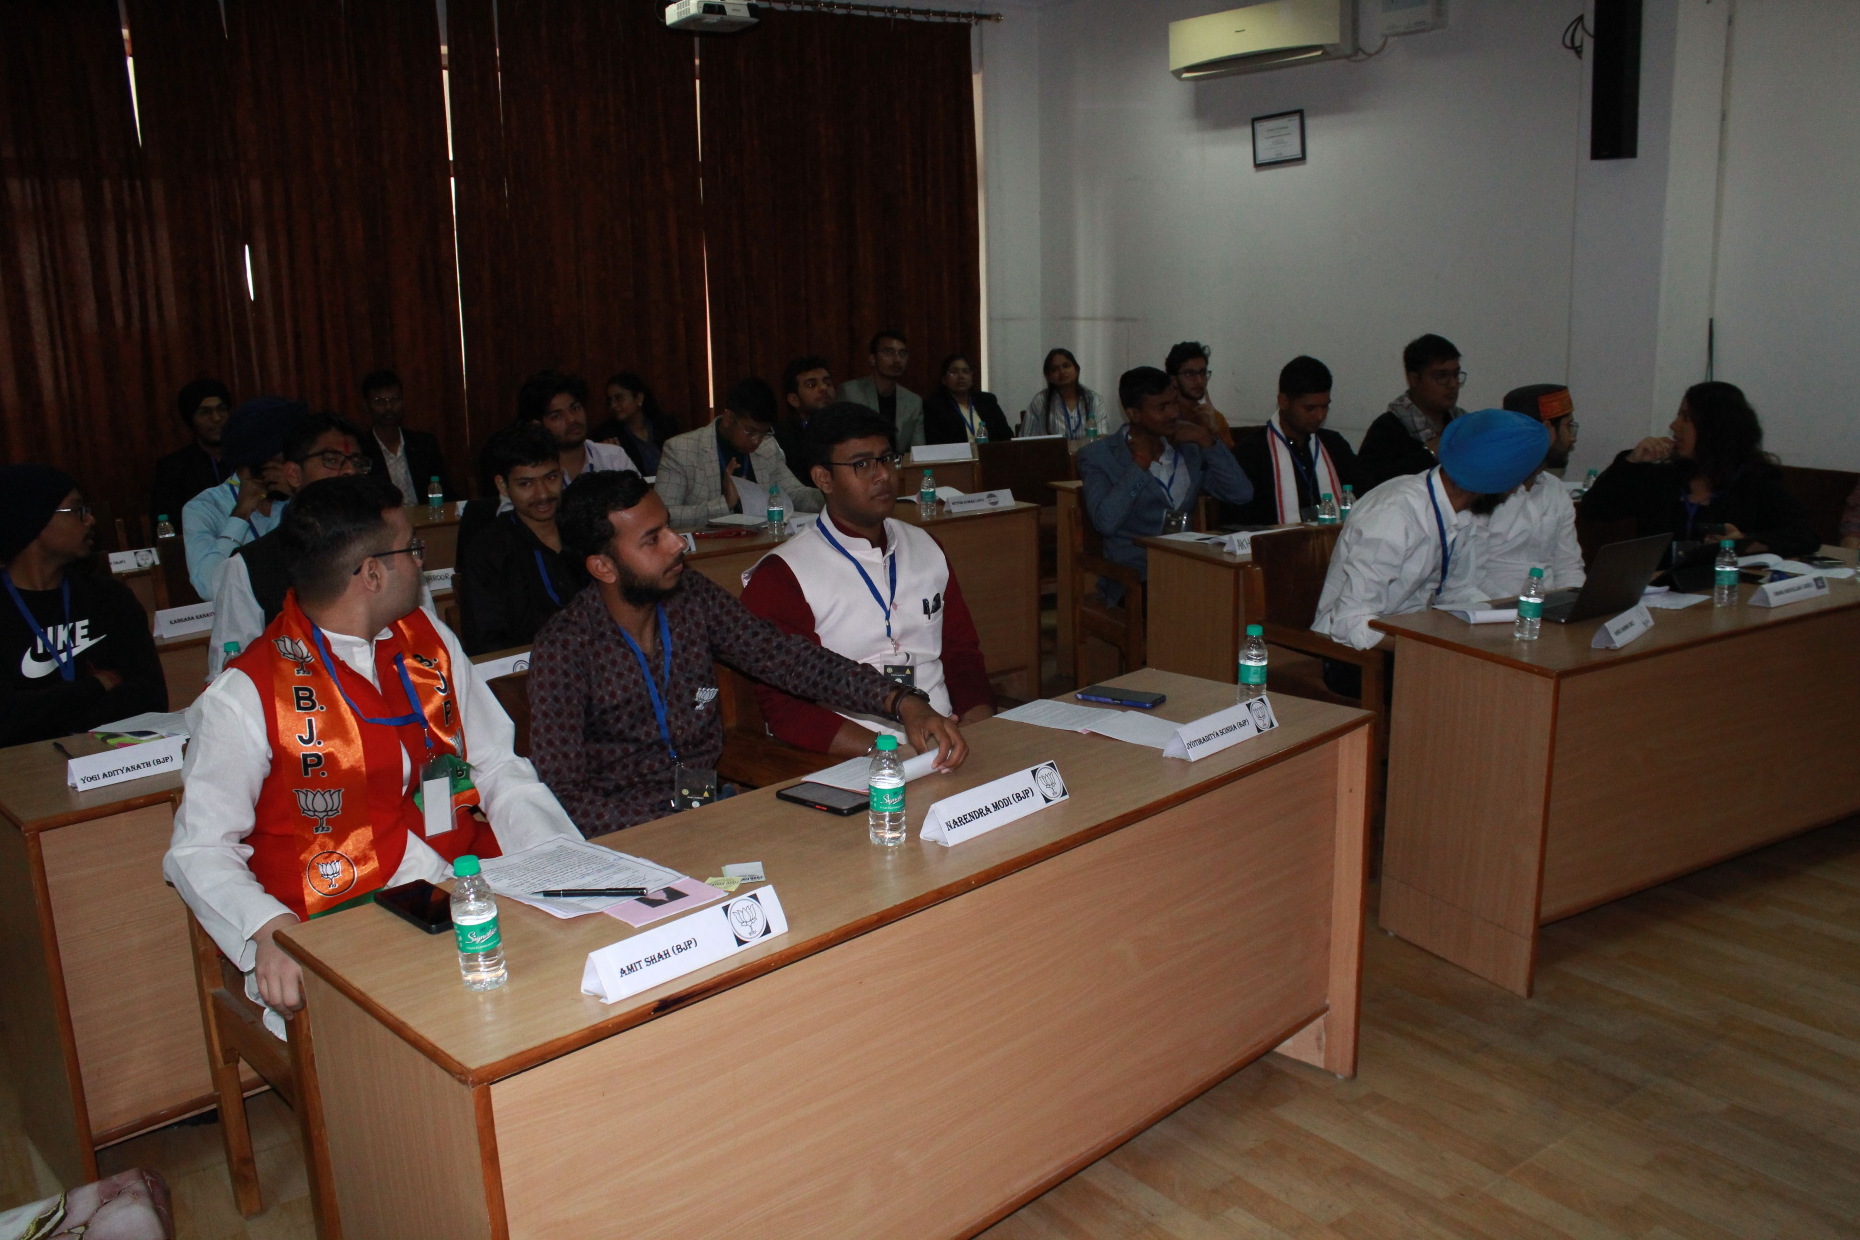
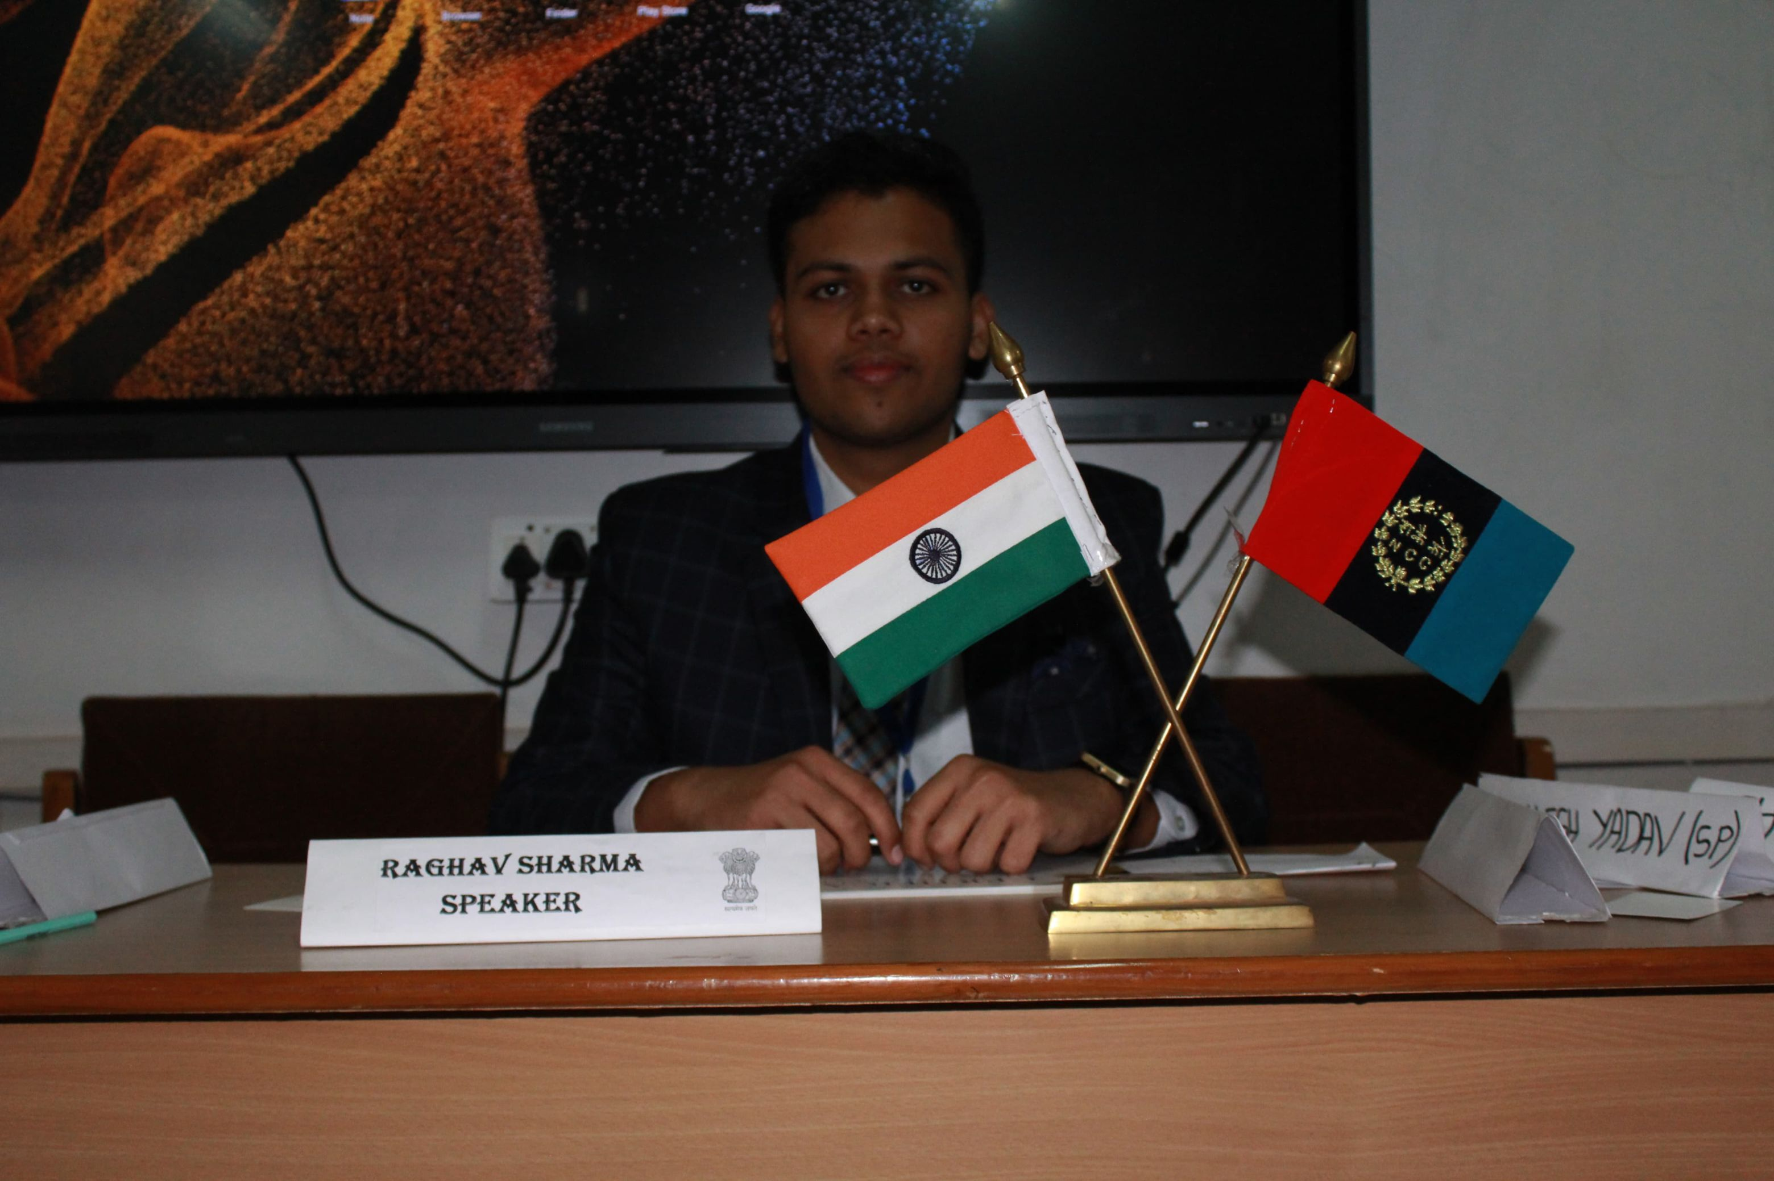
.
Debate and Discussion Hour After the initial exchange of statements, the participants were provided with refreshments, allowing for a brief intermission before the structured discussion began. The first chit, raised by the National Democratic Alliance (NDA), addressed the Model Code of Conduct, setting the tone for a thought-provoking debate. This was followed by the second chit from the Indian National Alliance (INA), which brought to light various electoral problems, further intensifying the discussion.

Slide 12
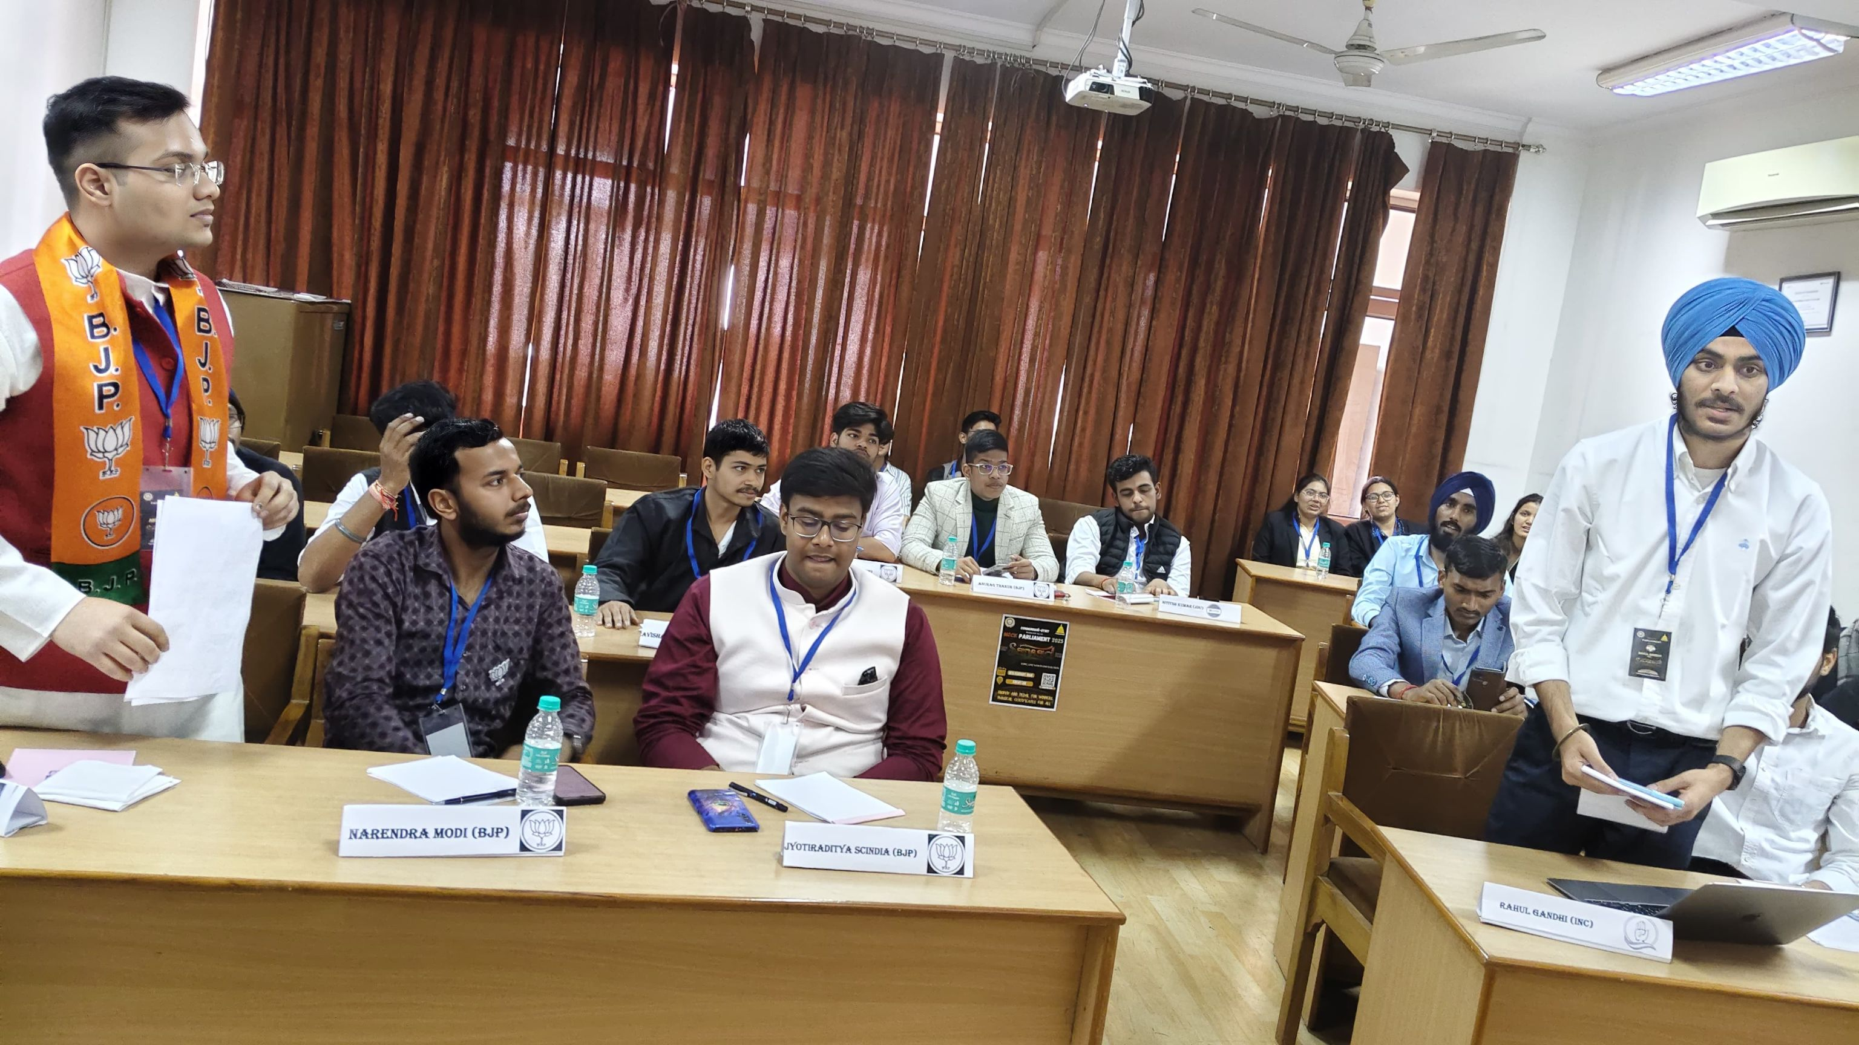
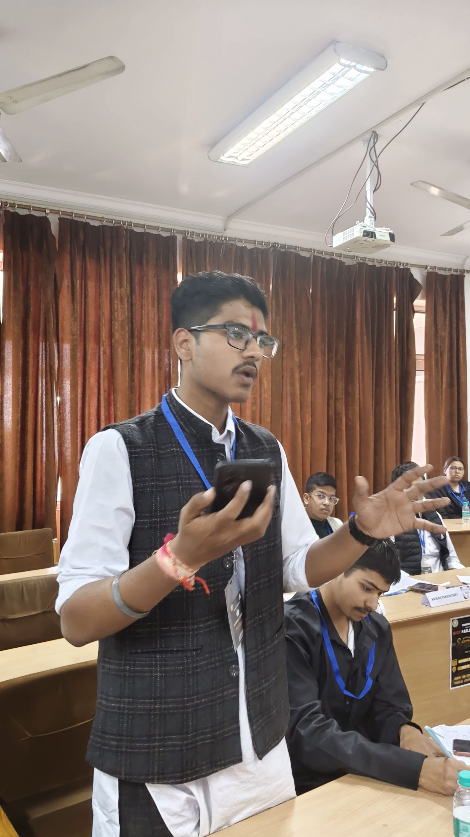
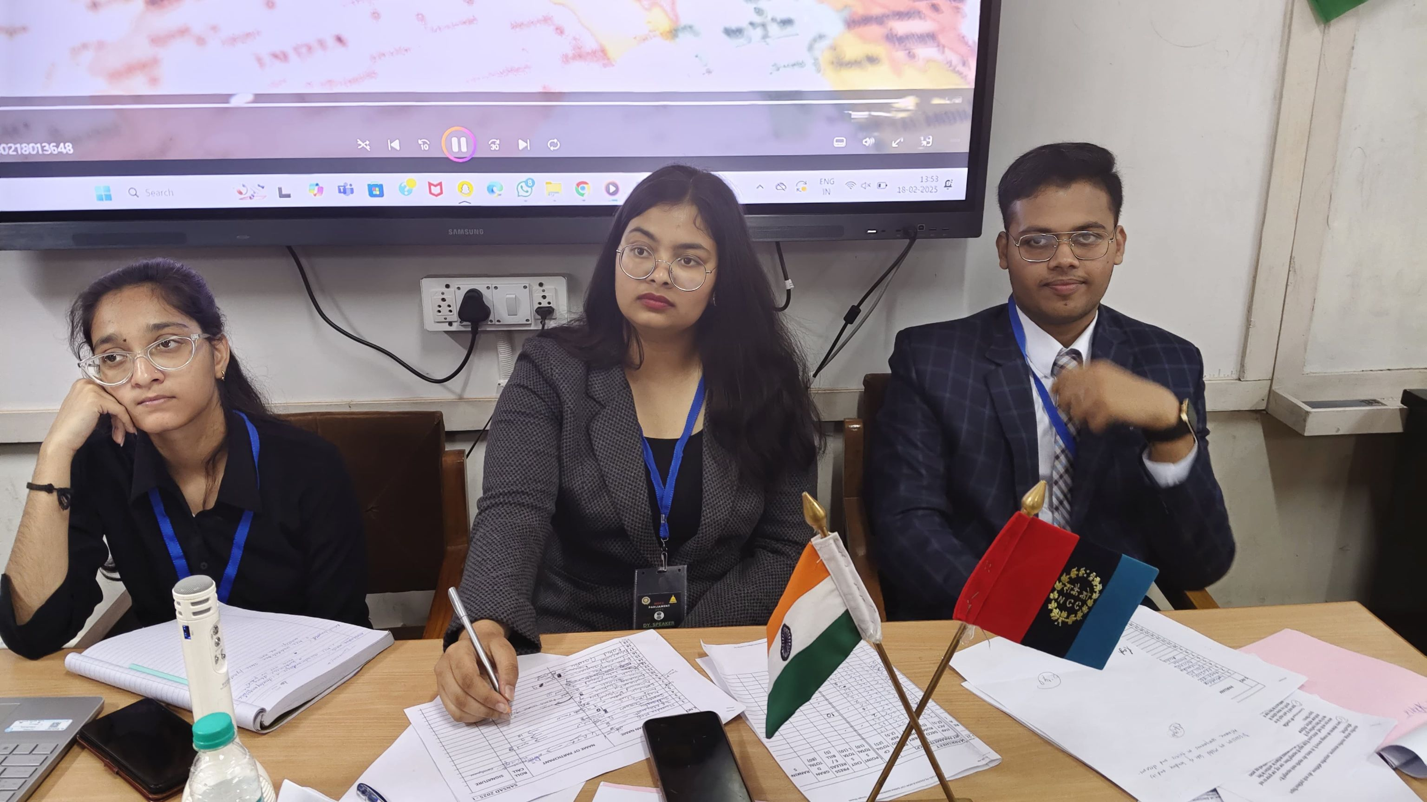

Slide 13
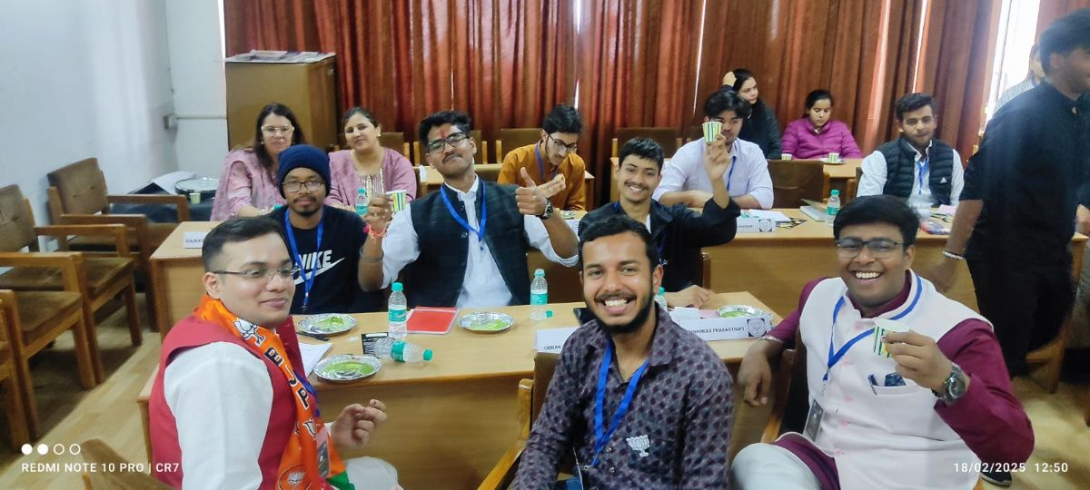

Slide 14
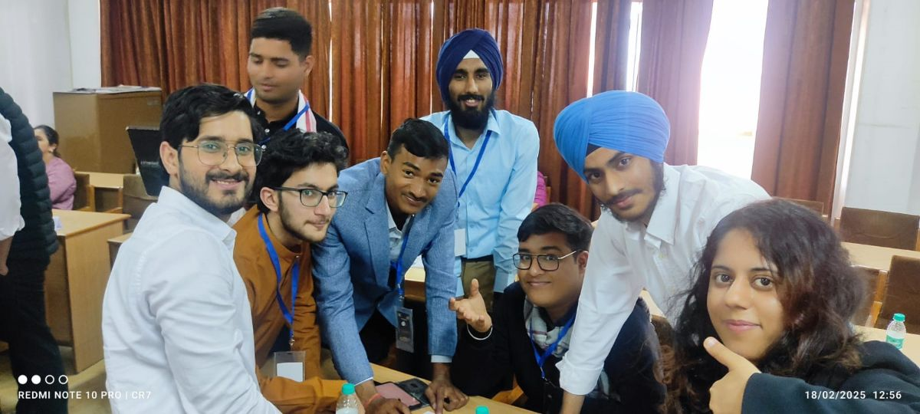
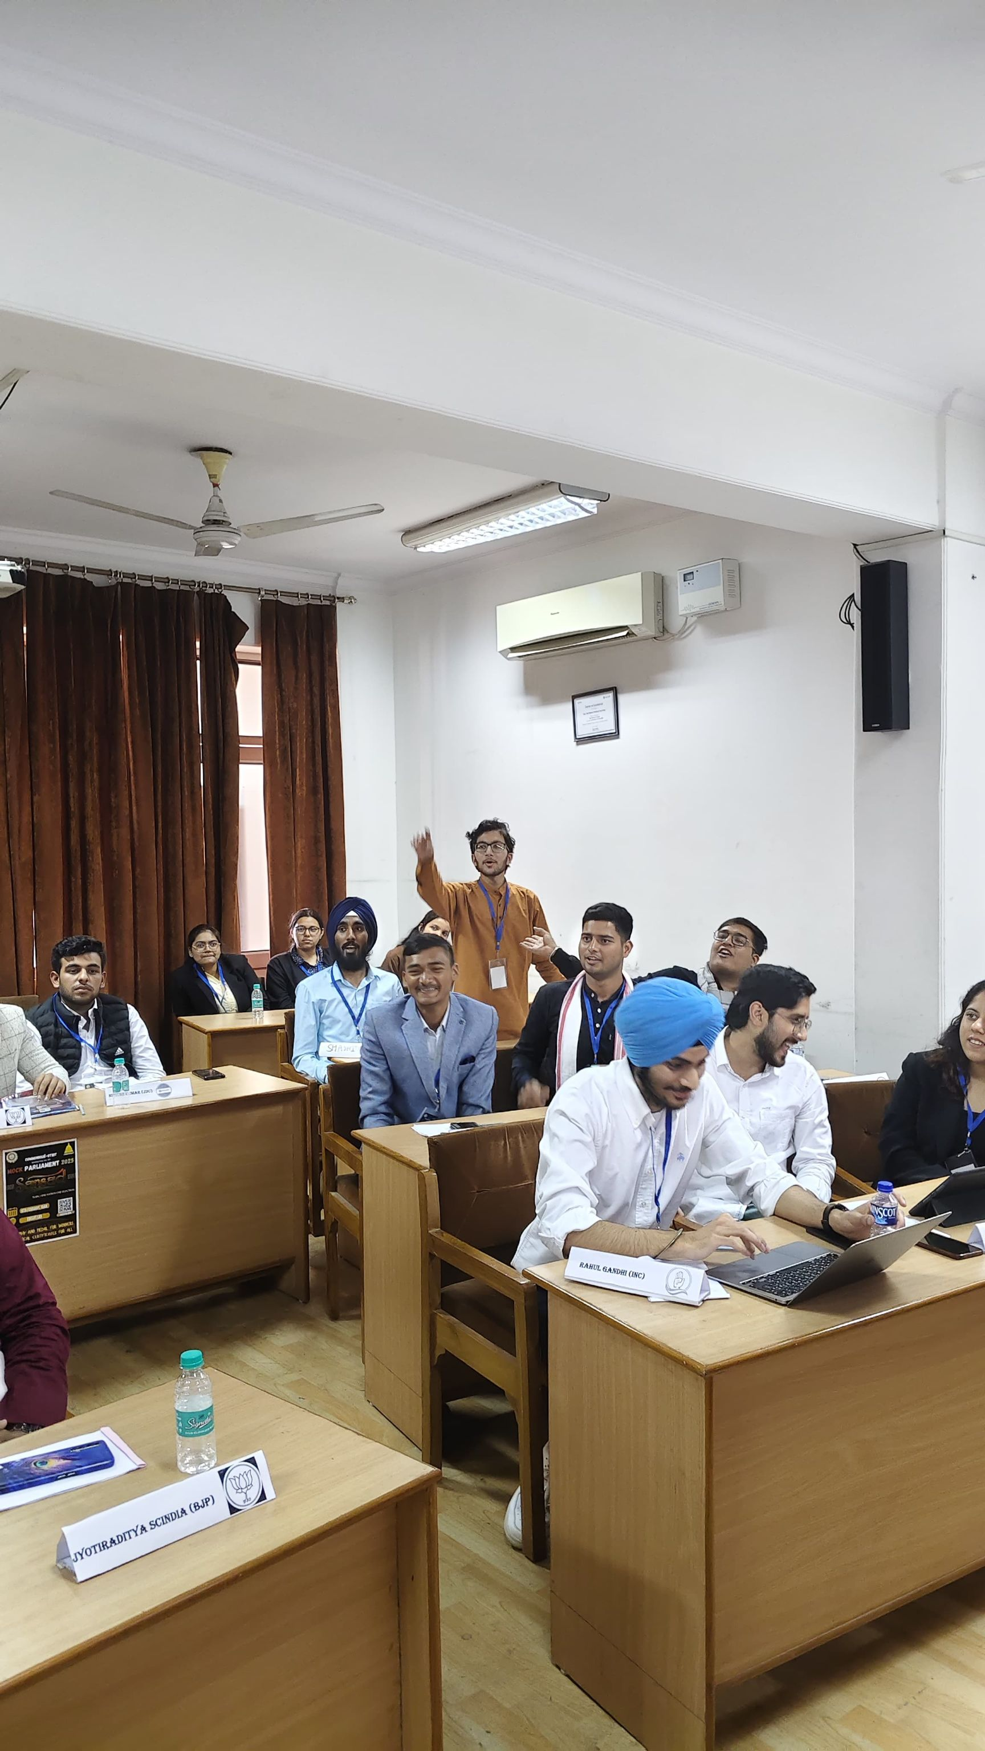
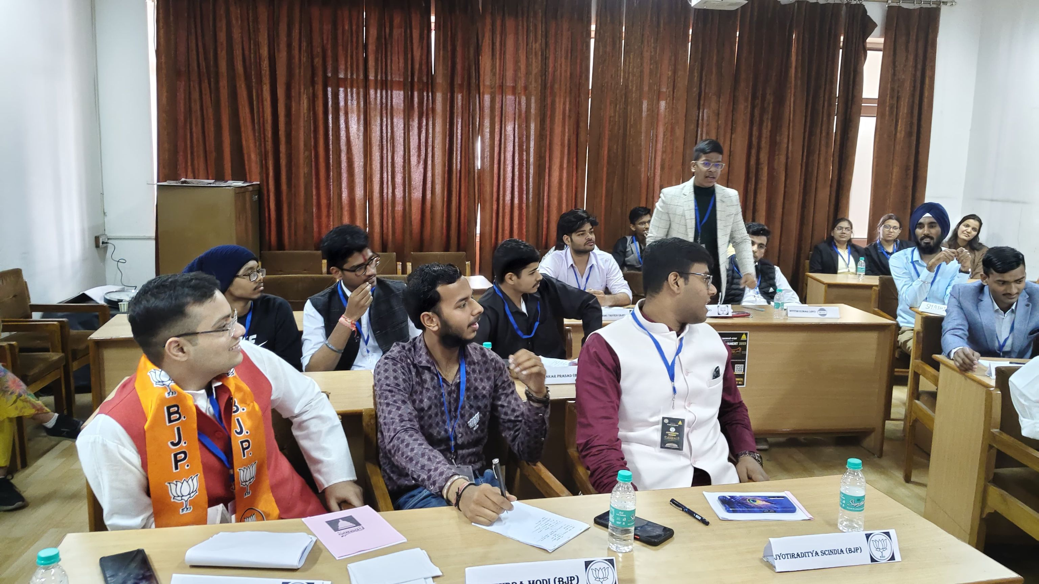
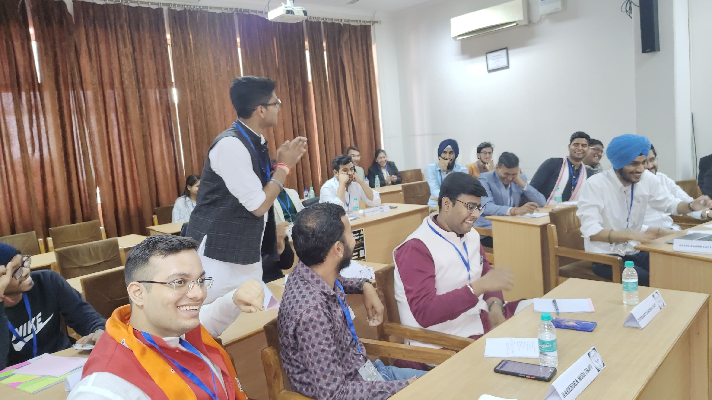

Slide 15
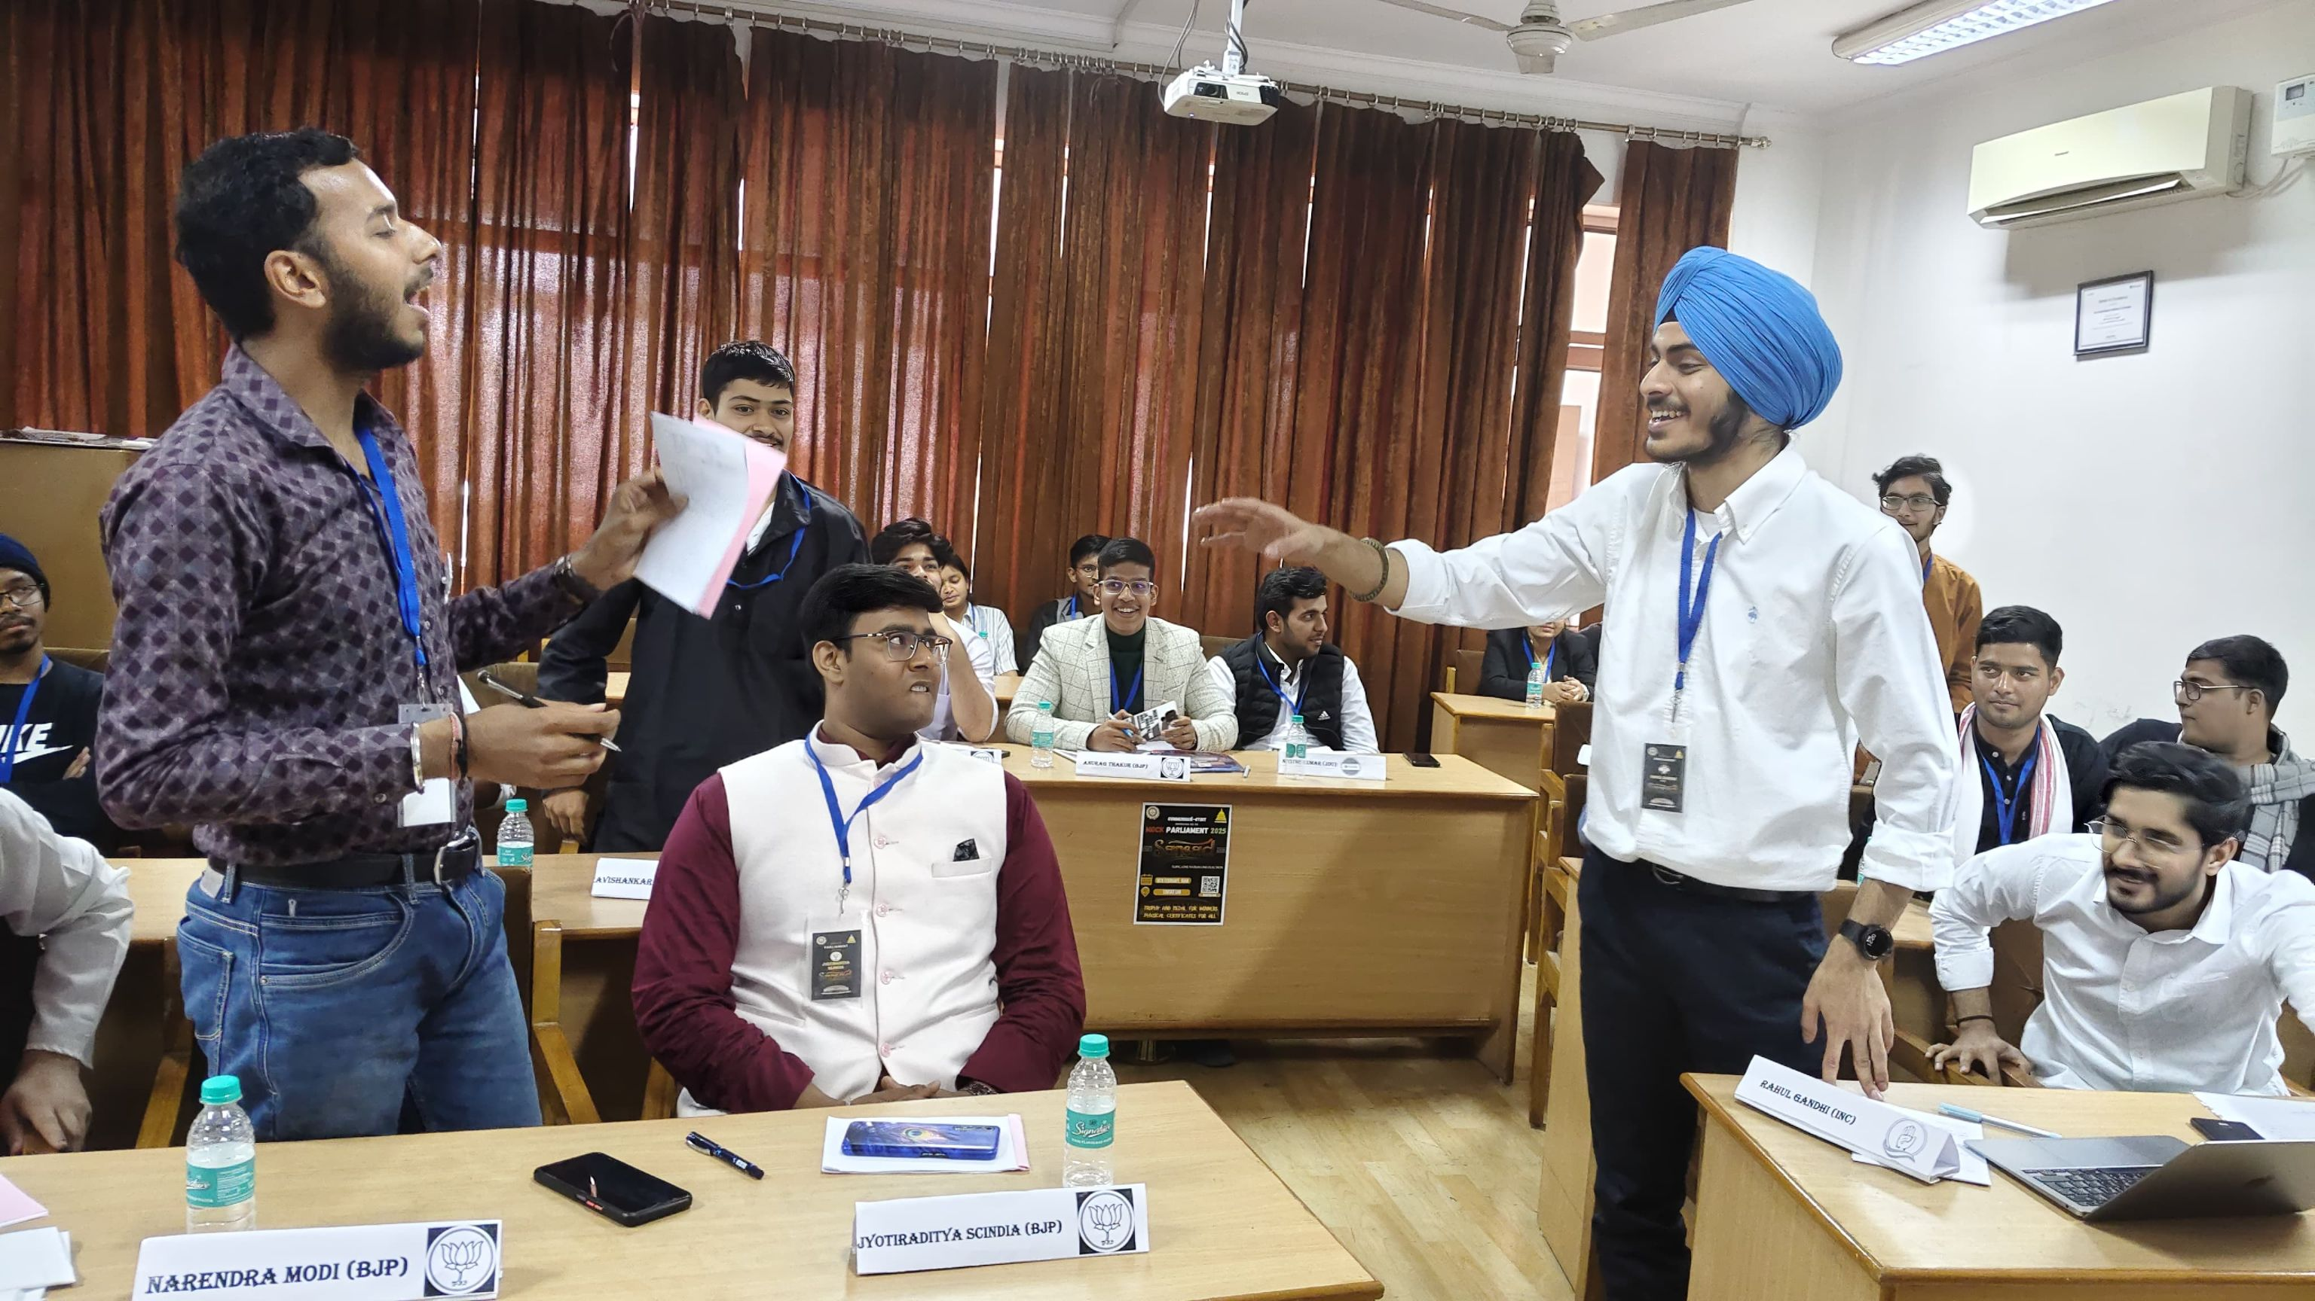

Slide 16
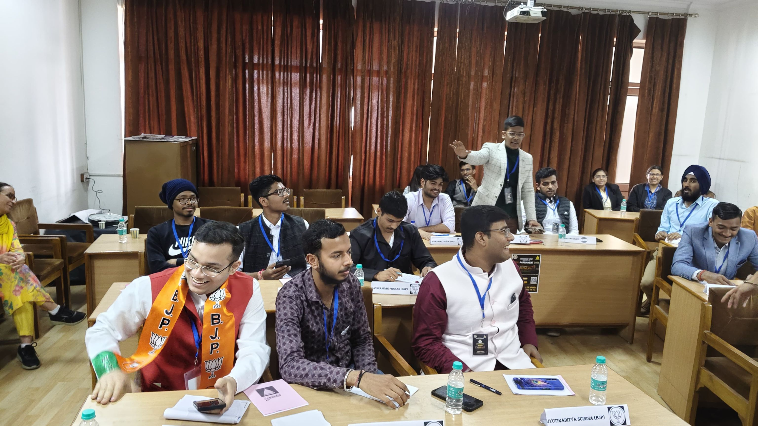

Slide 17
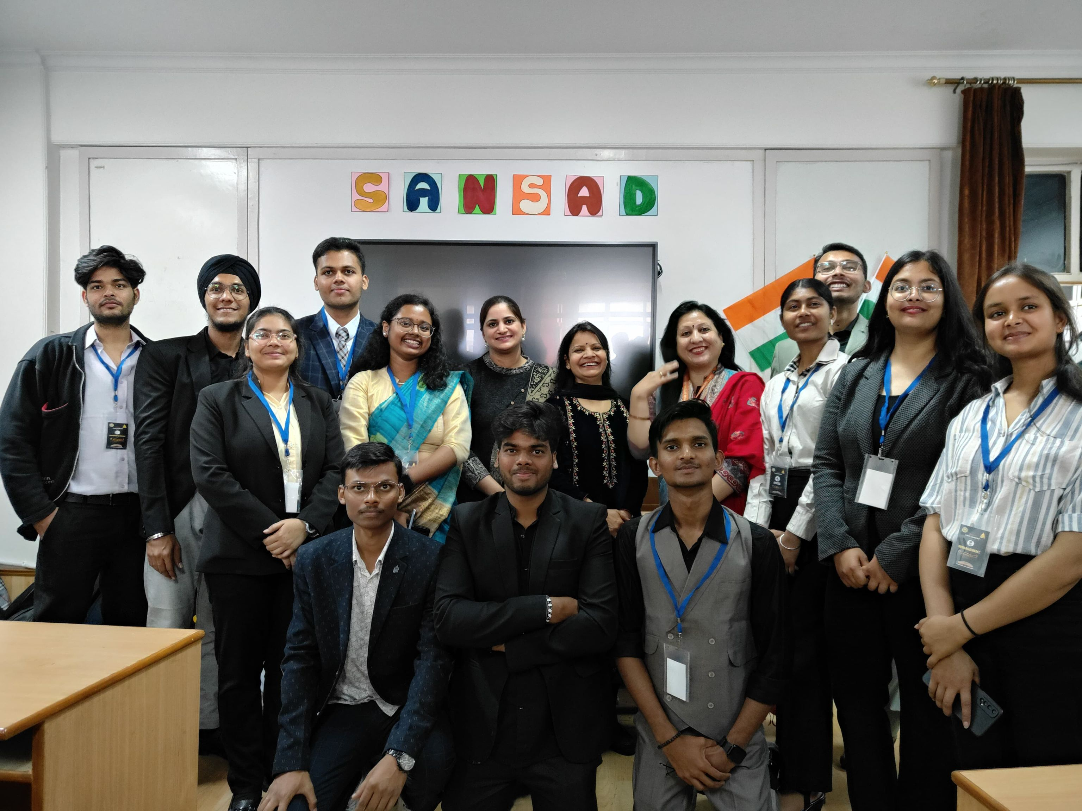
Following the debate, closing statements summarized key points. Participants proceeded for lunch as results were finalized. Mr. Ashish (Head of CSE), Dr. Seema, and Dr. Archana Dagar announced the results and felicitated winners. Dr. Seema praised the organizing team and encouraged continued participation in such intellectual activities.
.

Slide 18
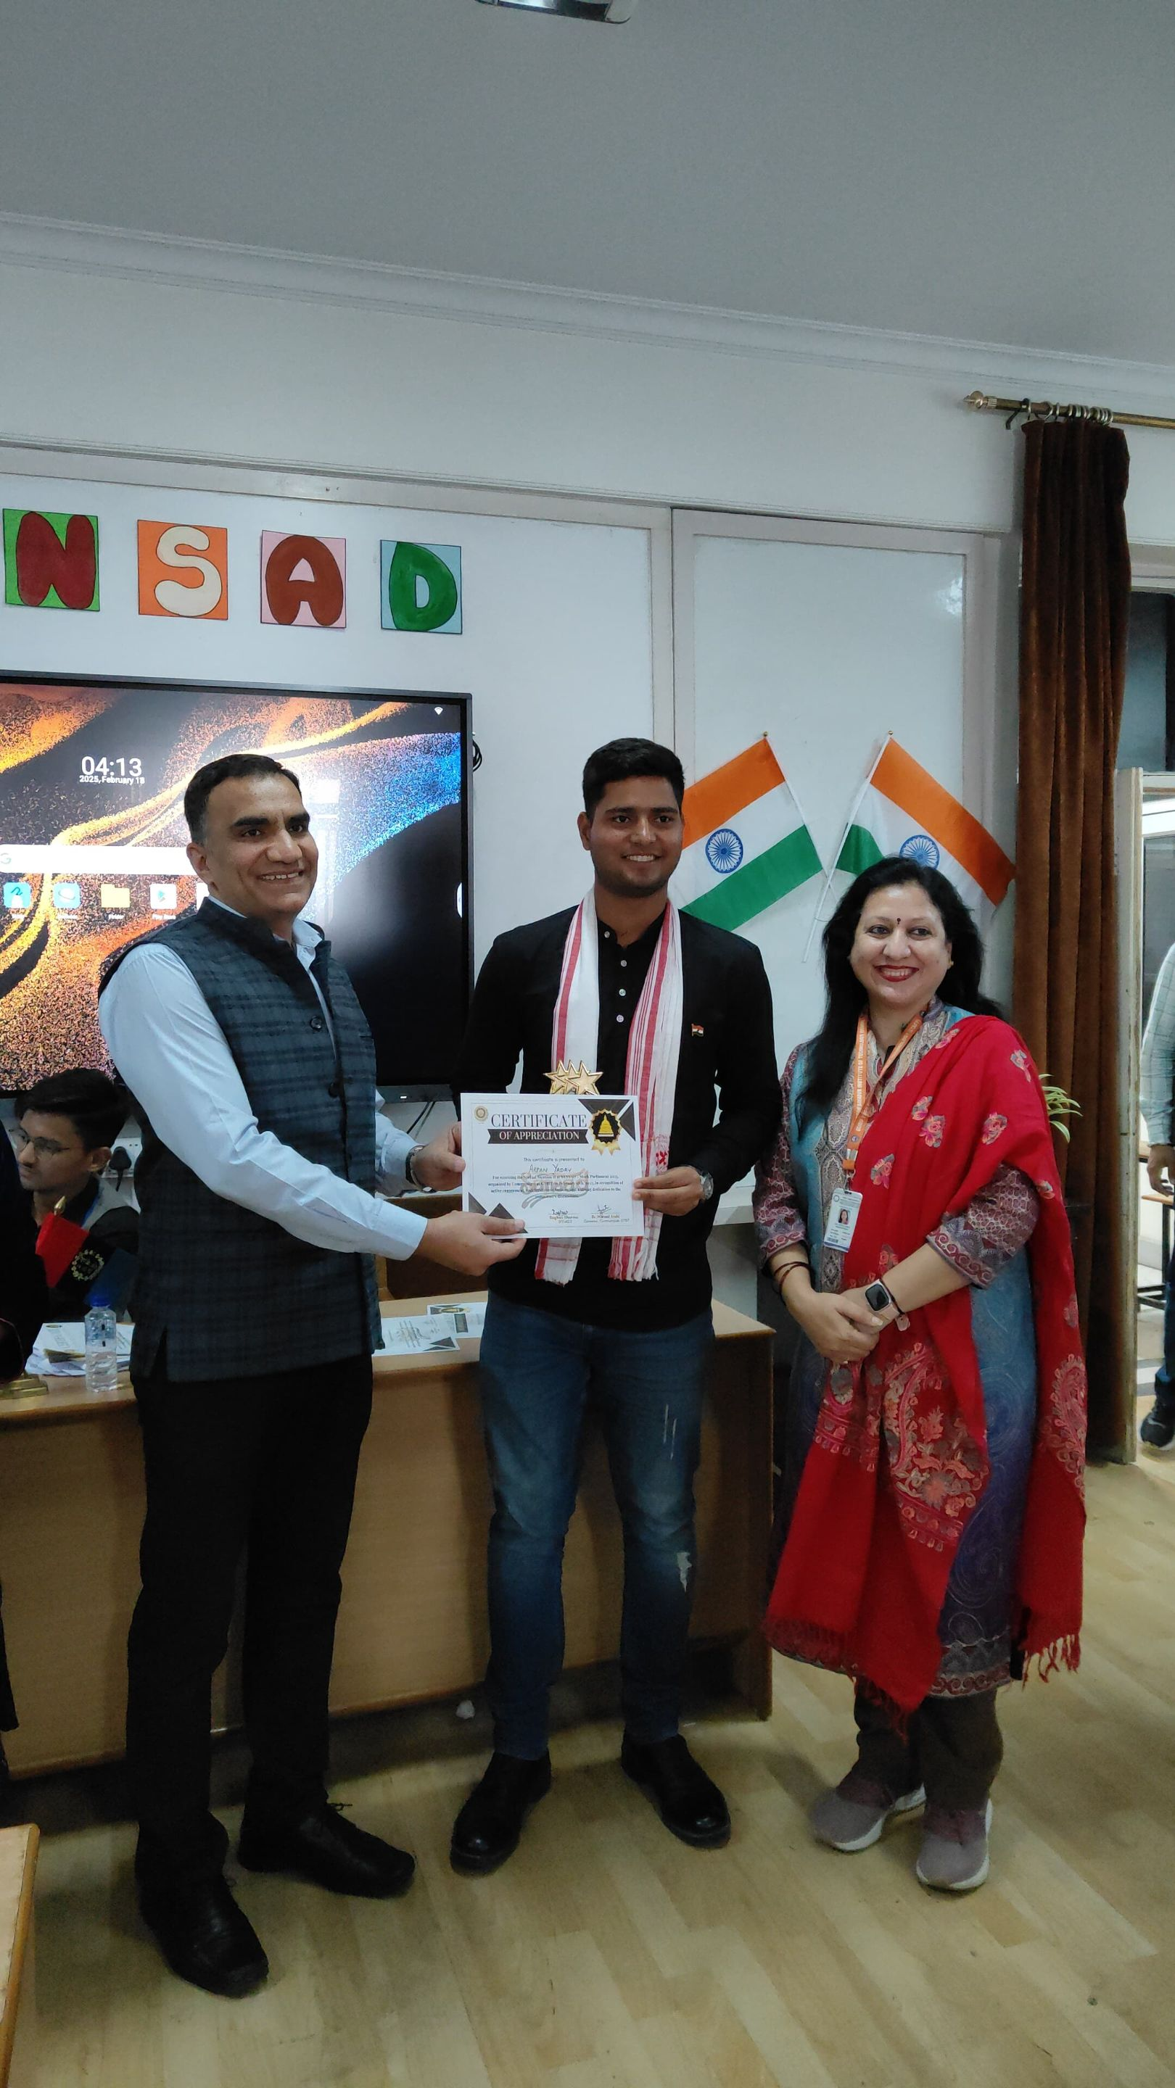
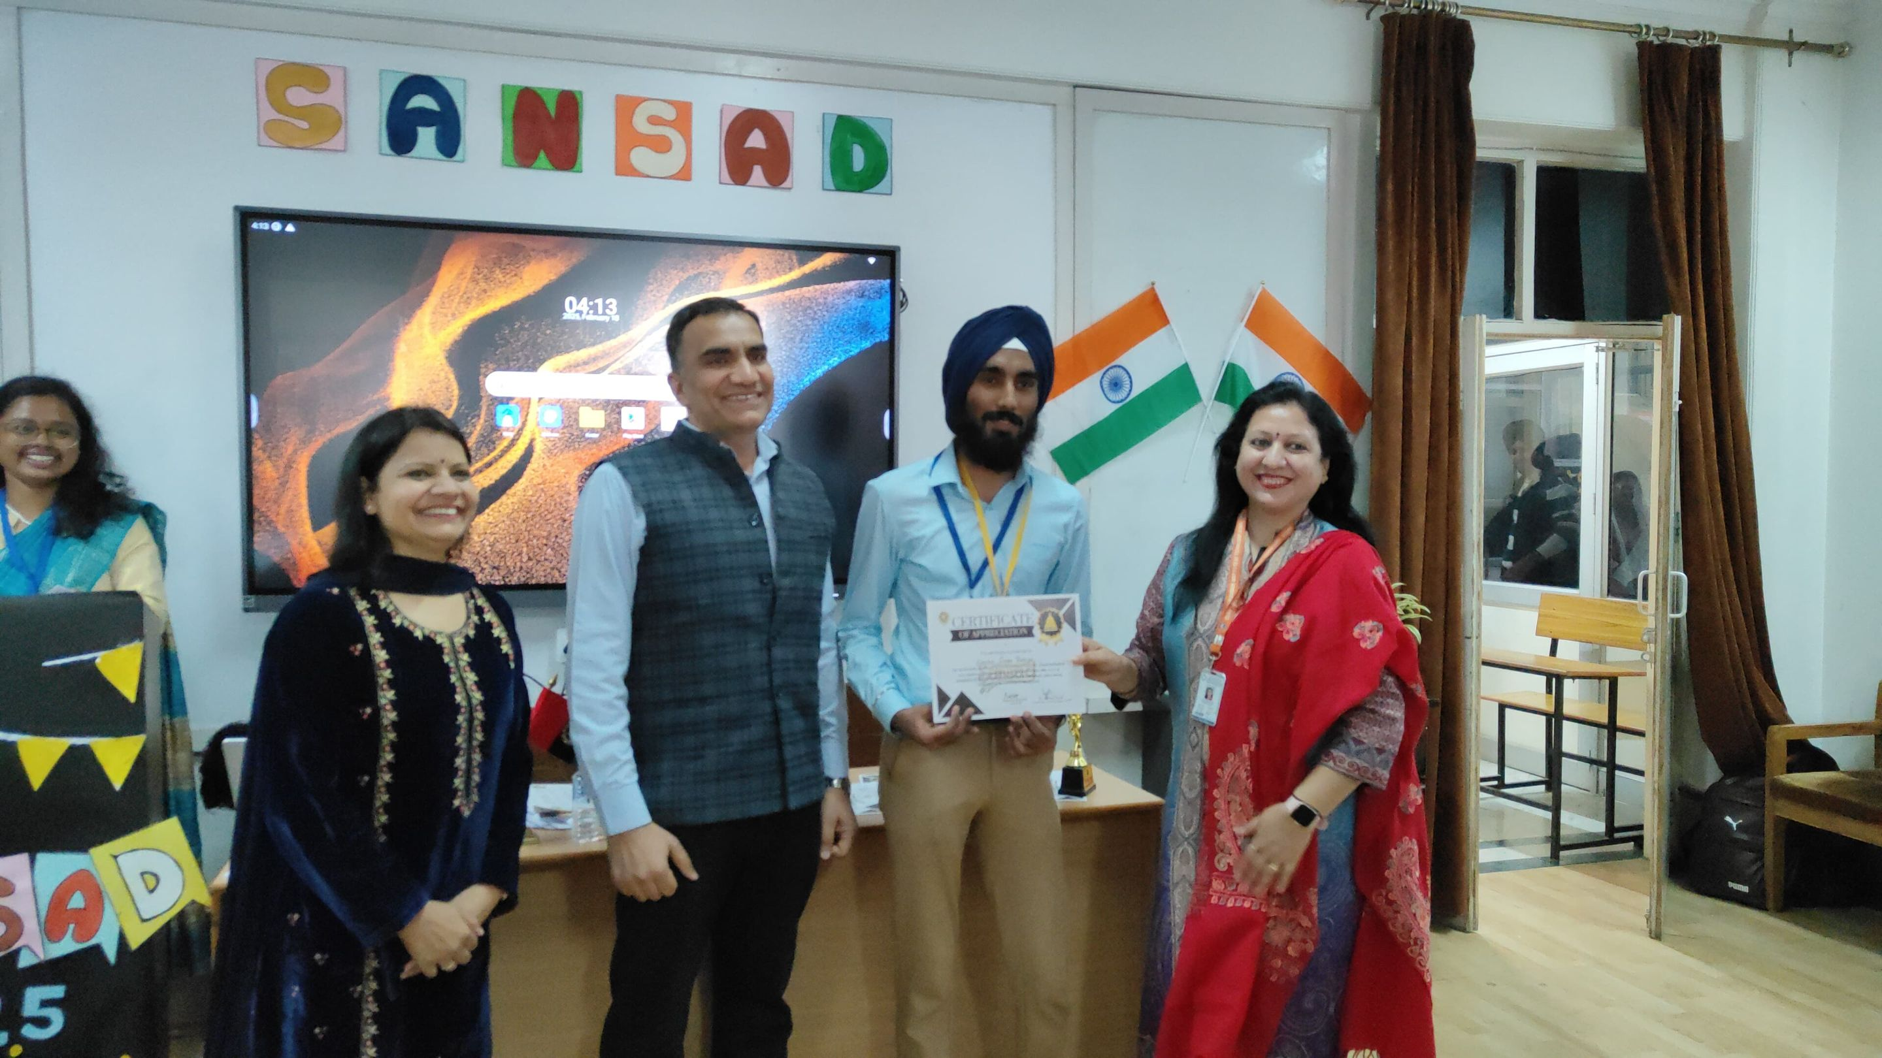
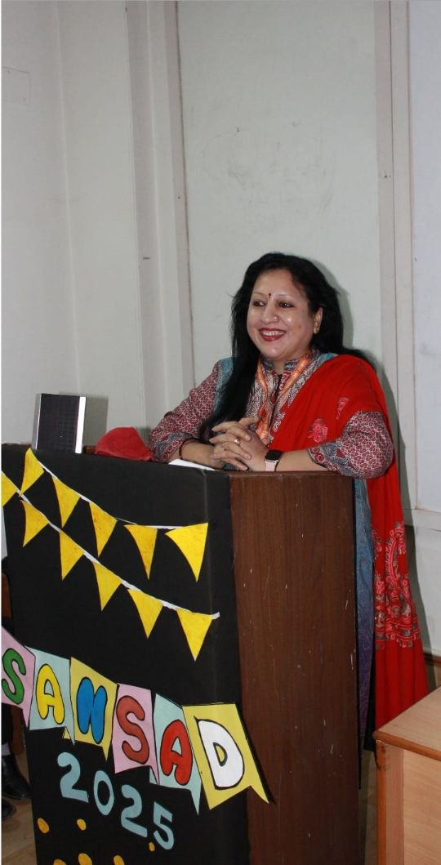
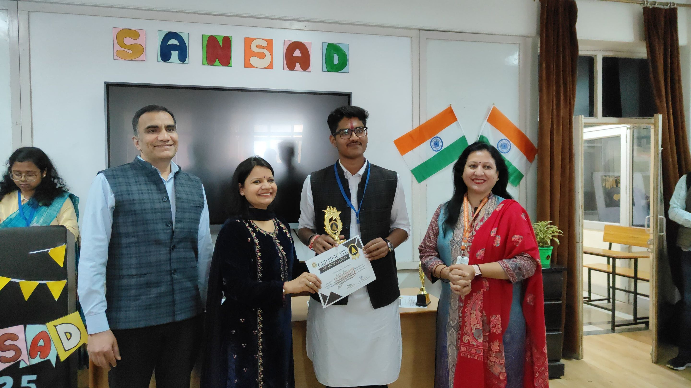
.

Slide 19
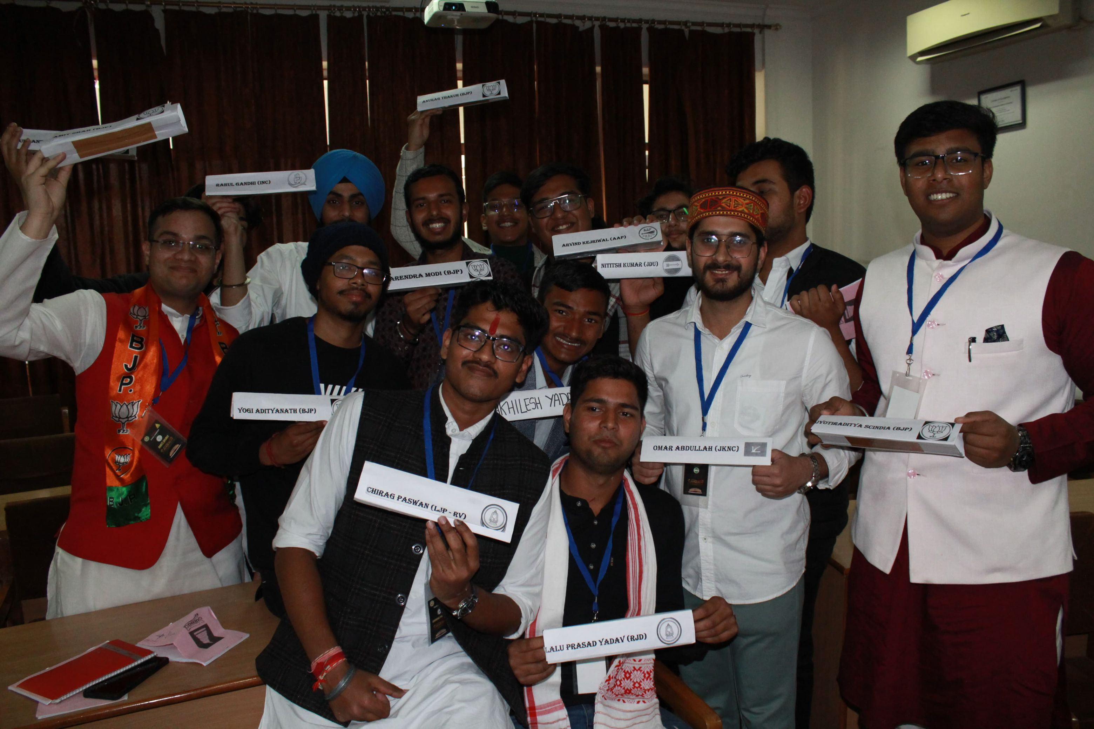
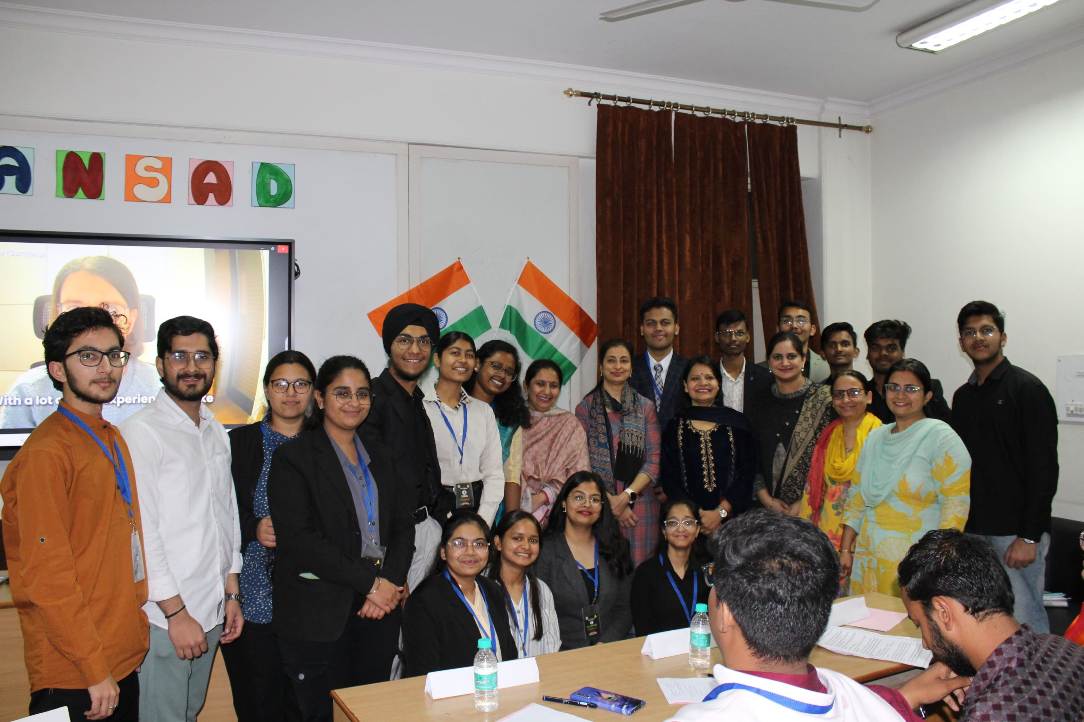
Conclusion:
The event concluded with a vote of thanks and a photography session. Sansad was a resounding success, reinforcing the value of structured debate, analytical thinking, and student engagement. It set a strong precedent for future events, aligning with Communiqué's mission to nurture articulate and informed leaders

Slide 20
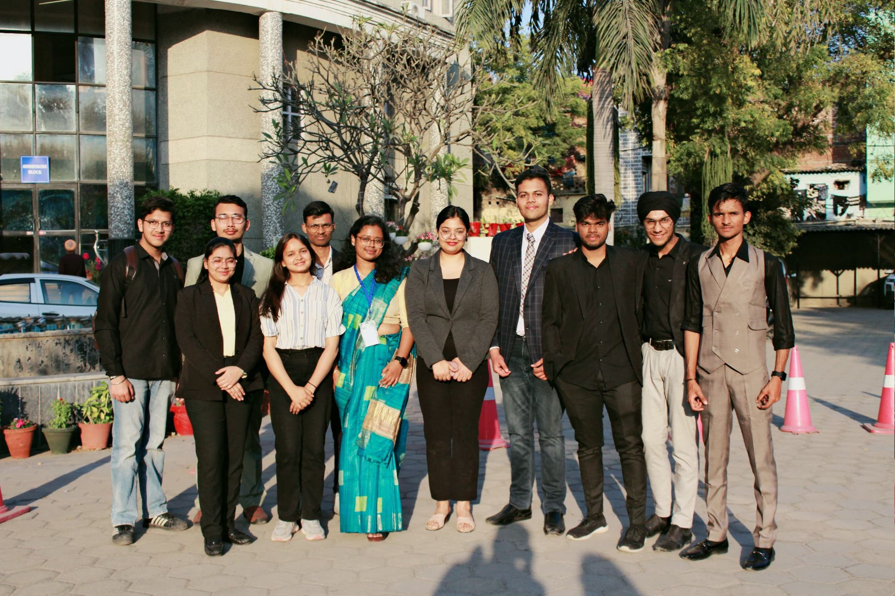

Slide 21
THANK YOU

